Slide 1


International Applicants
AHA Enters Its Second Century of Science
The American Heart Association has invested more than $5.7 billion in research that has
led to many advances in cardiovascular health and propelled the careers of
15 Nobel Prize winners.
For ALL research programs – including fellowships – applicants are not required to reside in the United States for any period before applying for AHA funding.
Rheumatic Heart Disease Research
The AHA is supporting a broader approach to funding Rheumatic Heart Disease research. Awardees will be designated from the existing applicant pool within each program.

Slide 2
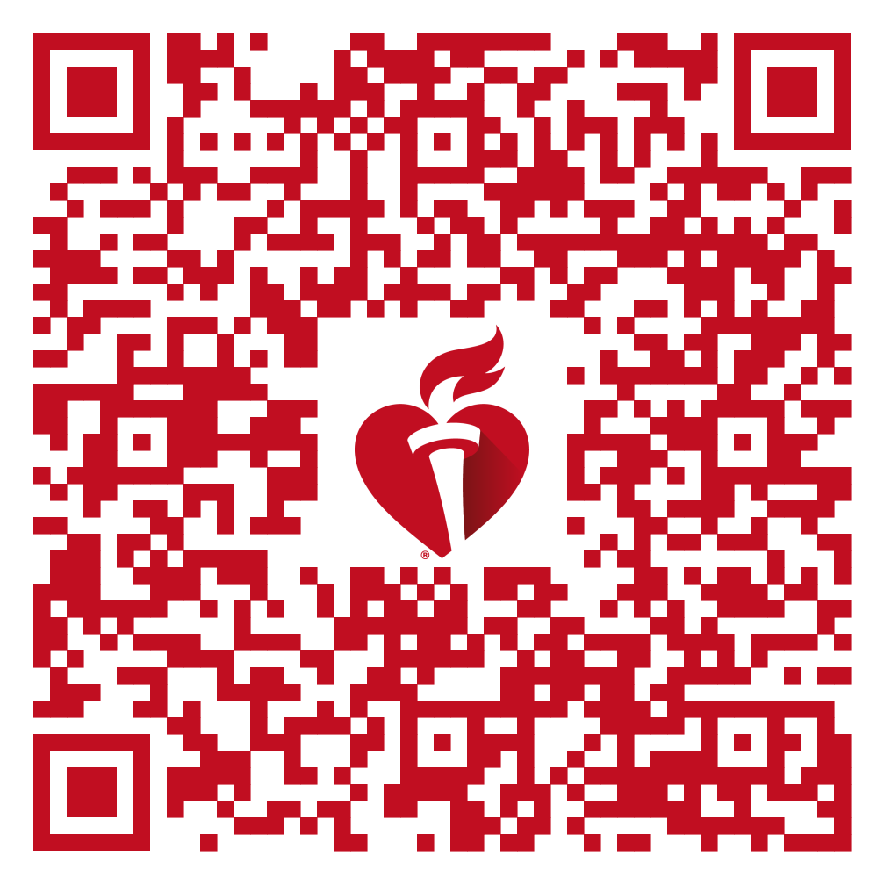
AHA Offers
Investigator-Initiated Research
Topic-focused Funding
Data Science Grants
AHA Registry Research
Funding for all career stages – from undergrads to senior investigators
Research Funding Deadlines
Funding open to AHA Members Only
Start your
application today!
Scan to access information on these funding opportunities.

