Slide 1
Repurposing Drugs for Treatment of Cardiovascular Disease Caused by SARS-CoV-2
Joseph Loscalzo, MD, PhD
Brigham and Women’s Hospital | Harvard Medical School
November 13, 2020

Slide 2
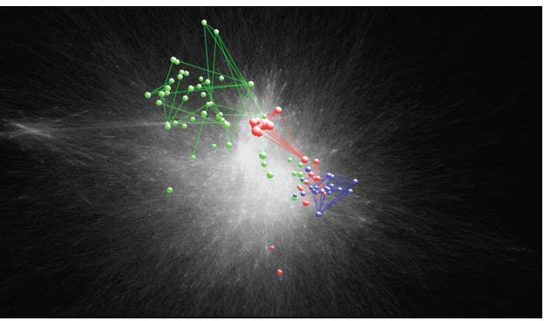
Disease Modules in the Interactome
13,470 Nodes
141,296 Edges
Curation of all experimentally validated protein-protein interactions in the human cell that form the human interactome
Peroxisomal Disorders
Rheumatoid Arthritis
Binary PPI (Y2H, IntAct, MINT)
Regulatory (TRANSFAC)
Metabolic (CORUM)
Kinase and Signaling Networks
Literature Curation (IntAct, MINT, BioGrid, HPRD)
Multiple Sclerosis
--Menche, et al., Science 2015;347:1257601

Slide 3
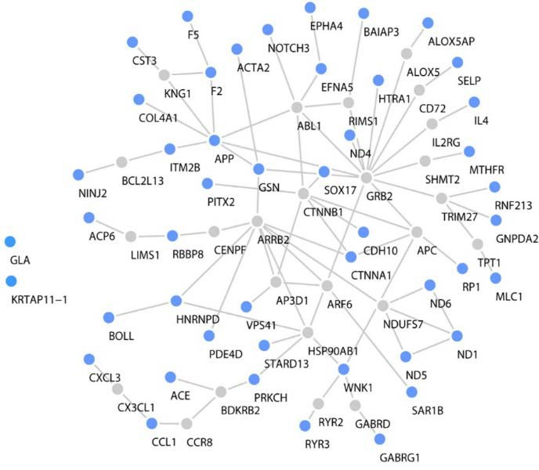
Disease Module Derivation: Cerebrovascular
Disease
CBVD Proto-module
Identify disease phenotype of interest (CBVD).
Ascertain disease network components (‘seed’ proteins).
Map ‘seed’ proteins to interactome.
Identify disease module(s) within interactome network.
Seed Proteins Connector Proteins
--Wang & Loscalzo, J Mol Biol 2018;430:2939-50
The interactome provides the ‘missing links’ among disease-associated proteins in the disease module.

Slide 4
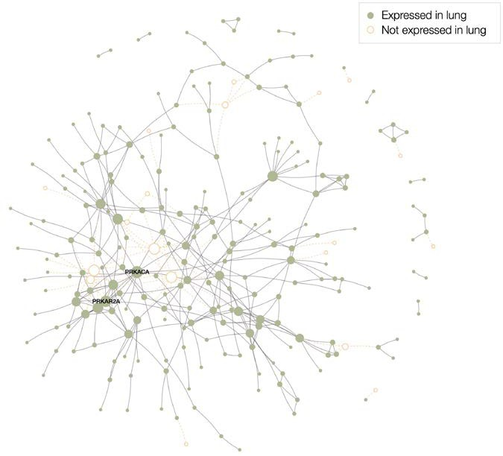
COVID-19 Disease Module: The Pulmonary Covidome
332 human proteins to which 26 SARS-CoV-2 proteins bind (Gordon et al., Nature, 2020), mapped to the interactome
Repurposing candidates must target proteins within the covidome or very near it.
https://arxiv.org/abs/2004.07229

Slide 5
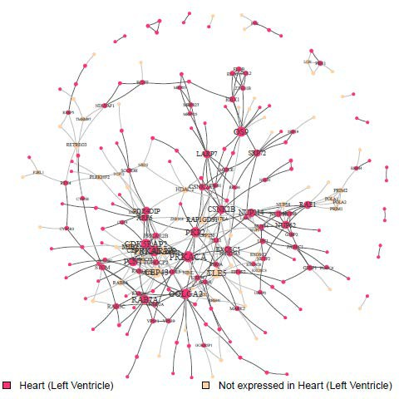
COVID-19 Disease Module: The Cardiac Covidome
332 human proteins to which 26 SARS-CoV-2 proteins bind (Gordon et al., Nature, 2020), mapped to the interactome
Repurposing candidates must target proteins within the covidome or very near it.

Slide 6
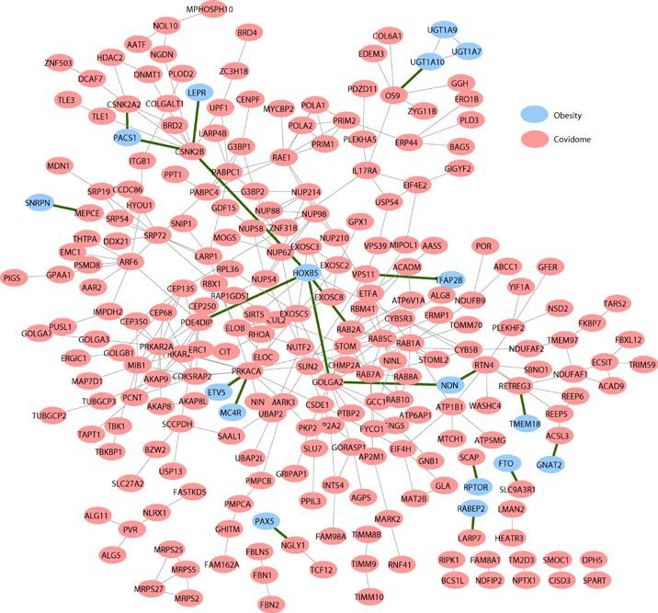
COVID-19 Disease Module: Overlap with Obesity Module
One of four disease modules that overlap with the covidome
Nominal statistical significance: p=0.06

Slide 7
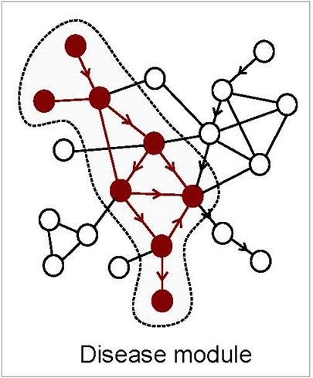

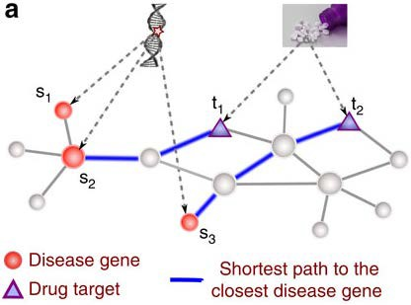

Two Strategies for Drug Target Identification
Network-based Drug Target ID
Network-based Drug Repurposing: The Proximity Hypothesis
Disease Module
Drug Target

Slide 8
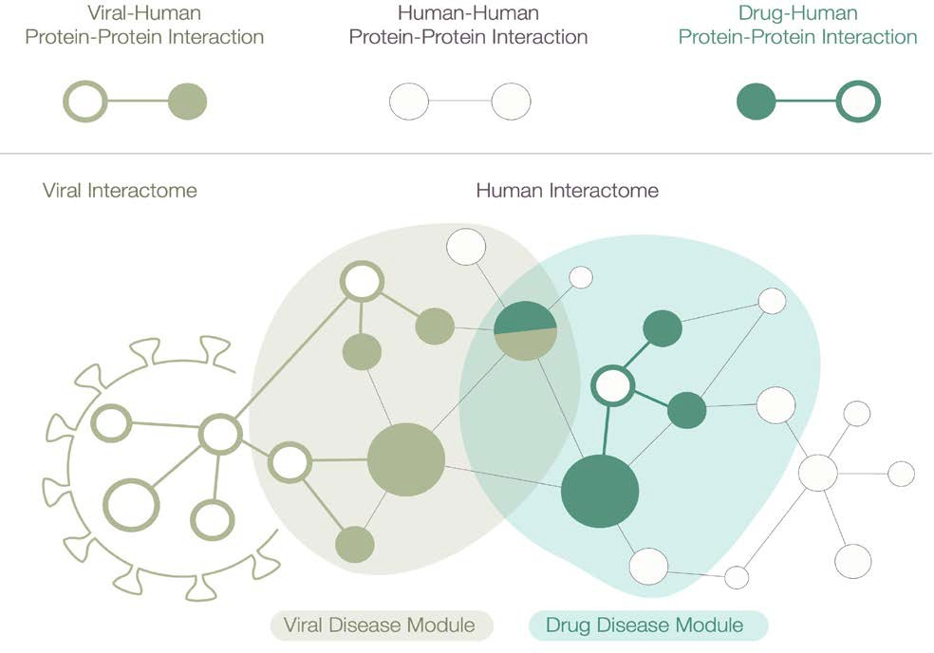
COVID-19 Disease Module and Interactions
Viral-Human Protein-Protein Interaction
Human-Human Protein-Protein Interaction
Drug Target-Human Protein-Protein Interaction
Viral Interactome
Human Interactome
Covidome
COVID-19
Disease Module
Drug Target- Disease Module
https://arxiv.org/abs/2004.07229

Slide 9


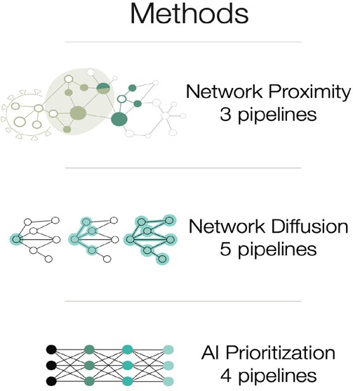
General Approach to Drug Target Identification in the Covidome
Network Proximity 3 pipelines
Network Diffusion 5 pipelines
Individual methods offer complementary information harnessed by the combined ranking algorithm for optimal predictive power.
Network AI 4 pipelines
https://arxiv.org/abs/2004.07229

Slide 10













Curated Drug Ranking & HTS
--Drugs in clinical trials shown in green--greater intensity indicates greater number of trials.
--Drugs with reported positive effects (e.g., ritonavir, ivermectin) appear in list.
--We cannot tell whether a drug on this list will suppress the infection or worsen it; in vitro testing is essential.
--This list does not provide information on other drug targets, which may lead to adverse effects (such as with hydroxychloroquine).
--HTS for SARS-CoV-2 in vitro viricidal activity yielded ~50% success rate (far greater than the
<1% hit rate of random screenings).
https://arxiv.org/abs/2004.07229

Slide 11




Creating a Comprehensive Atlas of Human Protein- Drug (Small Molecule) Interactions
Lawrence Livermore National Laboratory—Sierra System (near exa-scale) Center for Accelerated Drug Discovery
Human Proteins: 28,658 models for 14,119 proteins
Experimental structures (>35%): 7,874
Experimental structures (>10%): 9,894
M
Small Molecule Compounds: ~2M
ChEMBL:
Approved drugs:
Foodome: NCI60:
ZINC Biogenic:
1.5M
5,557
26,490
244,801
135,335
N
Specific interactions between drugs and protein targets will be used to map the drug targets to the PPI, which should yield comprehensive information on the breadth of disease treatments and adverse effects.

Slide 12
Ongoing Work
--Test top hits in human cell assays with SARS-CoV-2: HuH-7, Calu-3,
pericytes, ECs, CMs.
--Study repurposed drug combinations.
--LLNL--CADD high-performance computing analysis of potential repurposed drug targets in or near the covidome
--Proposed human trials

Slide 13
Acknowledgements
Laszlo Barabasi
Rob Davey
Rishi Desai
Felice Lightstone
Joerg Menche
Sebastian Schneeweiss
Marinka Zitnik
Feixiong Cheng
Deisy Morselli Gysi
Italo Do Valle
Vlad Elgart
Dina Ghiassian
Diane Handy
Laurel Lee
Jane Leopold
Jun-Seop Song
Ruisheng Wang
Jerry Zhu

