Slide 1
Association of Angiotensin-Converting Enzyme Inhibitors or Angiotensin Receptor Blockers Use and Covid-19 Infection Among Patients with Hypertension
Jaejin An, Rong Wei, Hui Zhou, Tiffany Q. Luong, Ran Liu, Michael K. Gould, Matthew T. Mefford, Teresa N. Harrison, Beth Creekmur, Ming-Sum Lee, John J. Sim, Jeffrey W. Brettler, John P. Martin, Angeline L. Ong-Su, Kristi Reynolds
AHA Scientific Sessions, November 13-17, 2020
DEPARTMENT OF RESEARCH & EVALUATION

Slide 2
Disclosures
This work was supported by the American Heart Association (AHA) grant #810957. Prior to AHA funding, part of this work was supported by the Regional Research Committee of Kaiser Permanente Southern California, grant #KP-RRC-20200402.
JA reports grants from Novartis, Vital Strategies, and Merck & Co. outside the submitted work.
RW and TQL report grants from Novartis and Vital Strategies outside the submitted work.
KR reports grants from Novartis, Vital Strategies, Merck & Co., and Amgen outside the submitted work.
HZ, MKG, MTM, TNH, BC, ML, JJS, JWB, JPM, and ALO have no financial disclosures.

Slide 3
Background
The Covid-19 pandemic has generated concerns that use of angiotensin-converting enzyme inhibitors (ACEIs) or angiotensin receptor blockers (ARBs) may be associated with increased risk of Covid-19 infection or disease severity.
ACEIs or ARBs may upregulate angiotensin-converting enzyme 2 (ACE2) receptors and increase SARS-CoV-2 infectivity.¹
ACEIs or ARBs may be protective against Covid-19 by upregulating ACE2 and mitigating the inflammatory response in the lungs of infected patients.²
Epidemiologic studies have emerged to address this question, and these reports showed no increased risk of severity of Covid-19 associated with ACEI or ARB exposure.³⁻⁸
Limited information is available on the susceptibility of Covid-19.

Slide 4
Objective
Determine the risk of Covid-19 infection among patients with hypertension taking ACEIs or ARBs, compared with other frequently used antihypertensive medications* within a large, diverse hypertension population at Kaiser Permanente Southern California.
*Calcium channel blockers (CCB), beta-blockers (BB), thiazide or thiazide-like diuretics (TD)

Slide 5
Methods
Retrospective Study Cohort
Patients with hypertension as of March 1, 2020 (index date) from Kaiser Permanente Southern California
Had a test for Covid-19 between March 1 – May 6, 2020
Variables of Interest
Exposure:
1) Any ACEIs
2) Any ARBs
3) CCB/BB/TD (reference group)
4) Other antihypertensives
5) No antihypertensives
Outcome:
Positive reverse transcription polymerase chain reaction (RT-PCR) test for Covid-19
Statistical Analysis
Propensity score matching based on patient demographics, neighborhood income and education, insurance, body mass index, smoking, blood pressure, baseline comorbidities, and medication use.

Slide 6
Results
Among 824,650 patients with hypertension, 16,898 (2.0%) were tested for Covid-19.
Table 1. Patient demographic and clinical characteristics by antihypertensive drug exposure
 | ACEI 4,878 (29%) | ARB 3,473 (21%) | CCB or BB or TD 4,177 (25%) | Other Antihypertensives 377 (2%) | No Antihypertensives 3,993 (24%)
Age in years, mean | 64 | 66 | 65 | 71 | 61
Male, % | 53 | 40 | 39 | 58 | 45
Race/Ethnicity, %
Asian | 11 | 20 | 14 | 7 | 12
Black | 12 | 14 | 18 | 15 | 14
Hispanic | 36 | 31 | 27 | 28 | 39
Other/Unknown | 2 | 2 | 2 | 2 | 2
White | 39 | 33 | 39 | 48 | 33
Blood Pressure, %
<140/90 mm Hg | 82 | 80 | 82 | 87 | 72
<130/80 mm Hg | 44 | 40 | 43 | 53 | 36
Diabetes, % | 46 | 49 | 29 | 39 | 28
Heart failure, % | 7 | 8 | 10 | 19 | 3
Chronic kidney disease, % | 10 | 14 | 14 | 18 | 6

Slide 7
Results
Table 2. Incidence of Covid-19 Infection per 1000 Patients by Antihypertensive Drug Exposure
 | ACEI | ARB | CCB or BB or TD | Other Anti- hypertensives | No Anti- hypertensives
Covid-19 Infection per 1000 tested patients (95% CI) | 107.6 (98.8-117.2) | 102.8 (92.7-114.0) | 81.9 (73.6-91.0) | 58.4 (38.4-88.6) | 137.2 (126.2-149.2)
ACEI = angiotensin-converting enzyme inhibitors; ARB = angiotensin receptor blockers; BB = beta-blockers; CCB = calcium channel blockers; TD = thiazide diuretics

Slide 8
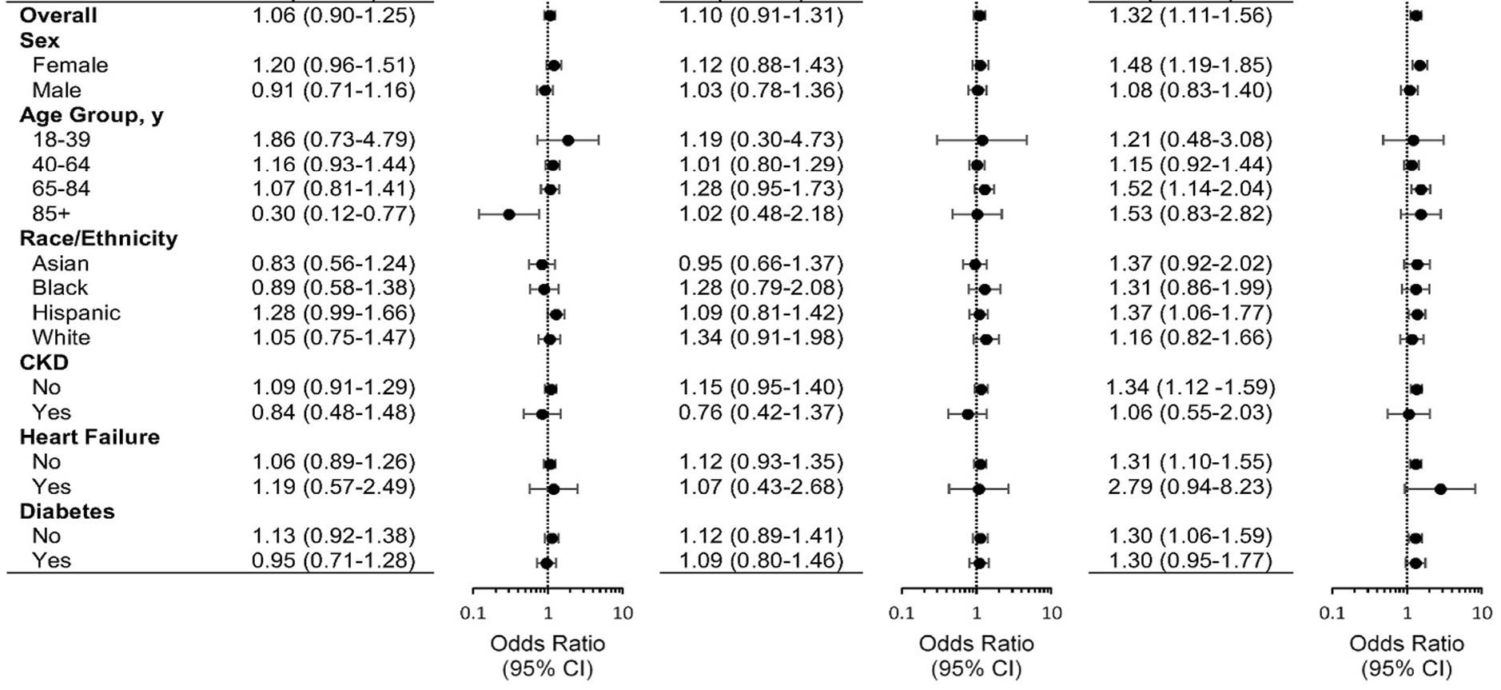
Results
Figure 1. Odds Ratio (95% CI) of Covid-19 Infection Associated with Antihypertensive Drug Exposure Stratified by Sex, Age, and Race/ethnicity After Propensity Score Matching
(A) ACEI vs. CCB/BB/TD (B) ARB vs. CCB/DD/TD (C) No antihypertensives vs. CCB/BB/TD

Slide 9
Summary of Findings/Discussion
In our racially and ethnically diverse cohort, neither ACEI nor ARB use was associated with increased likelihood of Covid-19 infection.
The decreased odds of Covid-19 infection among adults ≥85 years using ACEIs warrants further investigation.
This study showed an increased likelihood of Covid-19 infection for those without antihypertensive medications compared to those with CCB/BB/TD.
These results reinforce that patients with hypertension should continue their ACEIs or ARBs as recommended by scientific communities.
Study has limitations from unmeasured confounding and changes in testing criteria for Covid-19.

Slide 10
References
Fang L, Karakiulakis G, Roth M. Are patients with hypertension and diabetes mellitus at increased risk for COVID-19 infection? Lancet Respir Med.
2020;8(4):e21.
Vaduganathan M, Vardeny O, Michel T, McMurray JJV, Pfeffer MA, Solomon SD. Renin-Angiotensin-Aldosterone System Inhibitors in Patients with Covid-19. N Engl J Med. 2020;382(17):1653-1659.
de Abajo FJ, Rodriguez-Martin S, Lerma V, et al. Use of renin-angiotensin-aldosterone system inhibitors and risk of COVID-19 requiring admission to hospital: a case-population study. Lancet. 2020;395(10238):1705-1714.
Fosbol EL, Butt JH, Ostergaard L, et al. Association of Angiotensin-Converting Enzyme Inhibitor or Angiotensin Receptor Blocker Use With COVID- 19 Diagnosis and Mortality. JAMA. 2020;324(2):168-177.
Mancia G, Rea F, Ludergnani M, Apolone G, Corrao G. Renin-Angiotensin-Aldosterone System Blockers and the Risk of Covid-19. N Engl J Med.
2020;382(25):2431-2440.
Mehta N, Kalra A, Nowacki AS, et al. Association of Use of Angiotensin-Converting Enzyme Inhibitors and Angiotensin II Receptor Blockers With Testing Positive for Coronavirus Disease 2019 (COVID-19). JAMA Cardiol. 2020.
Reynolds HR, Adhikari S, Pulgarin C, et al. Renin-Angiotensin-Aldosterone System Inhibitors and Risk of Covid-19. N Engl J Med.
2020;382(25):2441-2448.
Vila-Corcoles A, Satue-Gracia E, Ochoa-Gondar O, et al. Use of distinct anti-hypertensive drugs and risk for COVID-19 among hypertensive people: a population-based cohort study in Southern Catalonia, Spain. J Clin Hypertens (Greenwich). 2020.

