Slide 1
American Heart Association
RESEARCH FUNDING OPPORTUNITIES
January 17, 2023
apply@heart.org
7/13/22

Slide 2
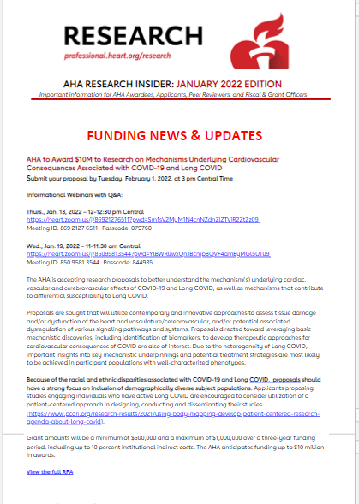
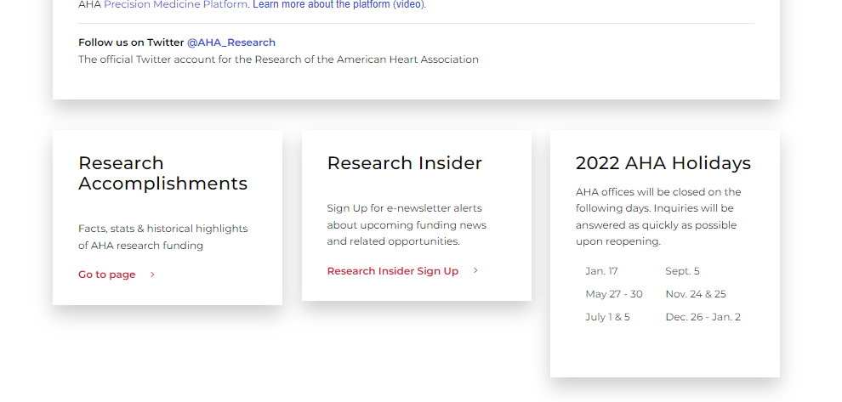
Professional Heart Daily

Slide 3
Mission & goals
AHA Mission
To be a relentless force for a world of longer, healthier lives.
2024 Impact Goal
Every person deserves the opportunity for a full, healthy life. As champions for health equity, by 2024,
the American Heart Association will advance
cardiovascular health for all, including identifying and removing barriers to health care access and quality.

Slide 4
RESEARCH IS THE FOUNDATION
Largest non-profit, non-governmental funder of cardiovascular & cerebrovascular research
$5 billion+ since 1949
Currently 1,440 active projects,
totaling $461.7 million

Slide 5
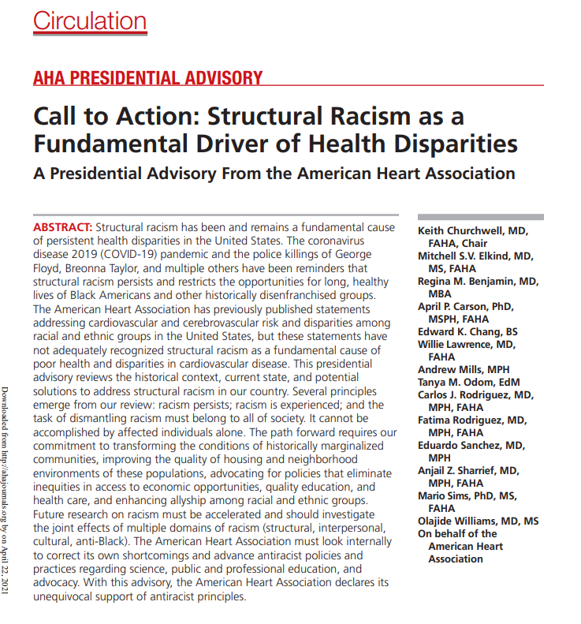
$100M Toward Health Equity & Structural Racism Research
Drive systemic public health change focused on removing barriers to equitable health for everyone, everywhere
New research programs & grants focused on health inequities & structural racism
Expand investigator diversity: Research opportunities for underrepresented racial & ethnic groups

Slide 6
strategically focused research topics
Board-directed – past examples:
COVID-related grants
Health Equity Research Networks
Prevention of Hypertension
Disparities in Maternal-Infant Health Outcomes
Rural Health Disparities (current)
End Nicotine Addiction in Children and Teens
Watch application information page
Sign up for monthly Research newsletter from our main web page: professional.heart.org/research

Slide 7
focused research topics
Funding Partner Organizations – 2023
Research focused on congenital heart defects effects of walnut consumption on health-related outcomes Barth Syndrome | Early Career Researchers in clinical vascular science anesthesiology cerebrovascular research related to vascular neurology, stroke and neurocritical care

Slide 8
Upcoming Proposal Deadlines
Program* | Pre-proposal Deadline | Proposal Deadline** | Award Start
Assessing Race in Clinical Research Models To take a fresh look at risk prediction models and algorithms in the field of cardiovascular and stroke science that have been adjusted for race, and reevaluate based on potential downstream inequities in disease outcomes and treatments. This award is targeted to predocs, postdocs, and fellows. | Monday, Jan. 23, 2023 | Monday, March 6, 2023 | July 1, 2023
Migraine as a Risk Factor for Stroke and Cardiovascular Disease To use large currently available databases (studies or electronic health record data) with information on migraine and cardiovascular disease, in combination with data science approaches, to assess migraine as a risk factor for cardiac disease and stroke. | Monday, Jan. 23, 2023 | Monday, March 6, 2023 | July 1, 2023
Health Equity Research Network (HERN) on Improving Access to Care and Other Health Inequities in Rural America This funding will support research that proposes novel solutions to meaningfully impact rural health disparities. | Thursday, Jan. 26, 2023 | Tuesday, April 4, 2023 | July 1, 2023

Slide 9
Upcoming Proposal Deadlines
Program* | Pre-proposal Deadline | Proposal Deadline** | Award Start
Research Supplement to Promote Diversity in Science Under the mentorship of current AHA awardees, this supports predoctoral and postdoctoral fellows from underrepresented racial and ethnic groups in science. |  | Wednesday, Feb. 1, 2023 | April 1, 2023
Transformational Project Award Highly innovative, high-impact projects that build on work in progress that could lead to critical discoveries or major advancements to accelerate cardiovascular and/or cerebrovascular research. Research deemed innovative may be built around an emerging paradigm, approaching an existing problem from a new perspective, or exhibit other uniquely creative qualities. |  | Thursday, Feb. 16, 2023 | July 1, 2023
AHA's Second Century Implementation Science Award For early and mid-career investigators proposing innovative implementation science studies that align with AHA’s mission and provide optimal approaches to improving public health. |  | Wednesday, March 1, 2023 | July 1, 2023
AHA's Second Century Early Faculty Independence Award For highly-promising investigators in the early years of their first professional appointment as they address areas of critical, emerging priority for the next century. | Tuesday, April 4, 2023 | Tuesday, May 9, 2023 | July 1, 2023

Slide 10
Foundational research funding
Professional.heart.org/fundingopportunities
In a typical year, the AHA offers research funding largely based on career stage:
Predoctoral Fellowship
Postdoctoral Fellowship
Institutional Award for Undergraduate Student Training
AHA Institutional Research Enhancement Award
Career Development Award
Collaborative Sciences Award
Innovative Project Award
Transformational Project Award
Merit Award
This Photo by Unknown Author is licensed under CC BY-SA-NC

Slide 11
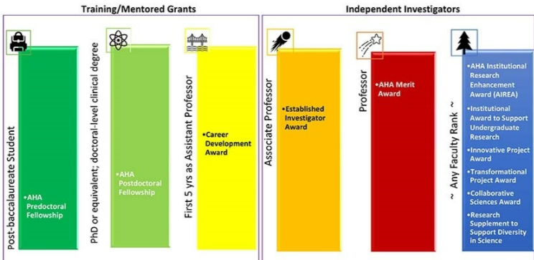
Career Levels Required for AHA Foundational Programs

Slide 12
FEATURES OF ALL AHA AWARDS
All academic and health professionals
Clinical, translational, population, behavioral, basic science
Women, underrepresented groups in research, non-traditional career trajectories encouraged
Most require no minimum percent effort
Fully transferrable
Straightforward re-budgeting
https://professional.heart.org/en/research-programs/application-information
Notes:
ELIZABETH COOPER:
A few years ago, we overhauled our research offerings to make award management more user-friendly. All AHA grants share these features, unless noted in the RFA:
Awards are open to the array of academic and health professionals. This includes but is not limited to all academic disciplines (biology, chemistry, mathematics, technology, physics, etc.) and all health-related professions (physicians, nurses, nurse practitioners, pharmacists, dentists, physical and occupational therapists, statisticians, nutritionists, etc.).
Clinical, translational, population, behavioral, and basic scientists are encouraged to apply. AHA maintains dedicated Peer Review Committees by program type, which are then subset by subject.
The AHA believes diversity and inclusion is an essential component to driving its mission. Therefore, we strongly encourages applications by women, people from underrepresented racial and ethnic groups in the sciences, military veterans, people with disabilities, members of the LGBTQ+ community, and those who have experienced varied and non-traditional career trajectories.
Most require no minimum percent effort, however, the Principal Investigator must demonstrate that adequate time will be devoted to ensuring successful completion of the project.
In addition
Grants to independent investigators are fully transferrable if an awardee moves to a new institution.
Award budgets are unrestricted among allowable categories.
Some award allow an individual to hold more than one AHA grant.

Slide 13
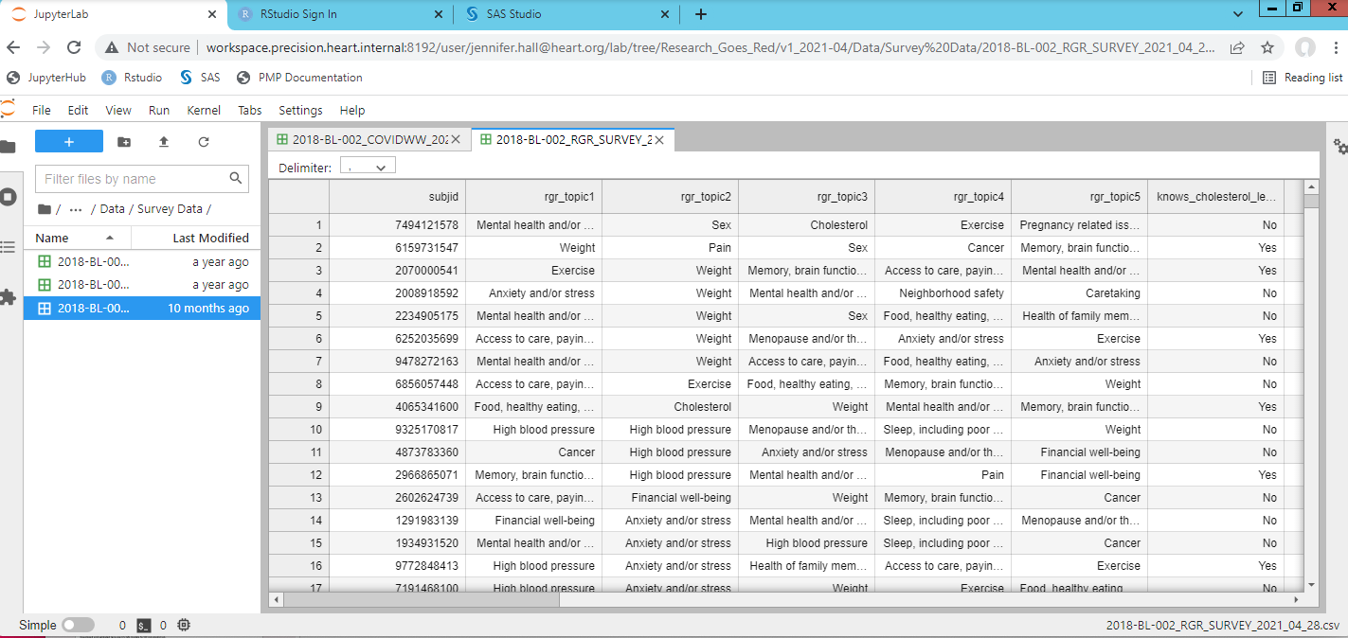
AHA Precision Medicine Platform
Highly secure cloud computing (AWS) workspaces equipped with analytical tools for research
Teams can easily collaborate; view the same data and code
Register for an account and workspace at precision.heart.org and include your Award ID
Please contact us with any questions – pmp@heart.org
Awardees are eligible for cloud credits!

Slide 14
AHA Open Science Policies
Increase discoverability and encourage broadest possible audience to access and build upon research results

Slide 15
Improve Your Chance of Funding

Slide 16
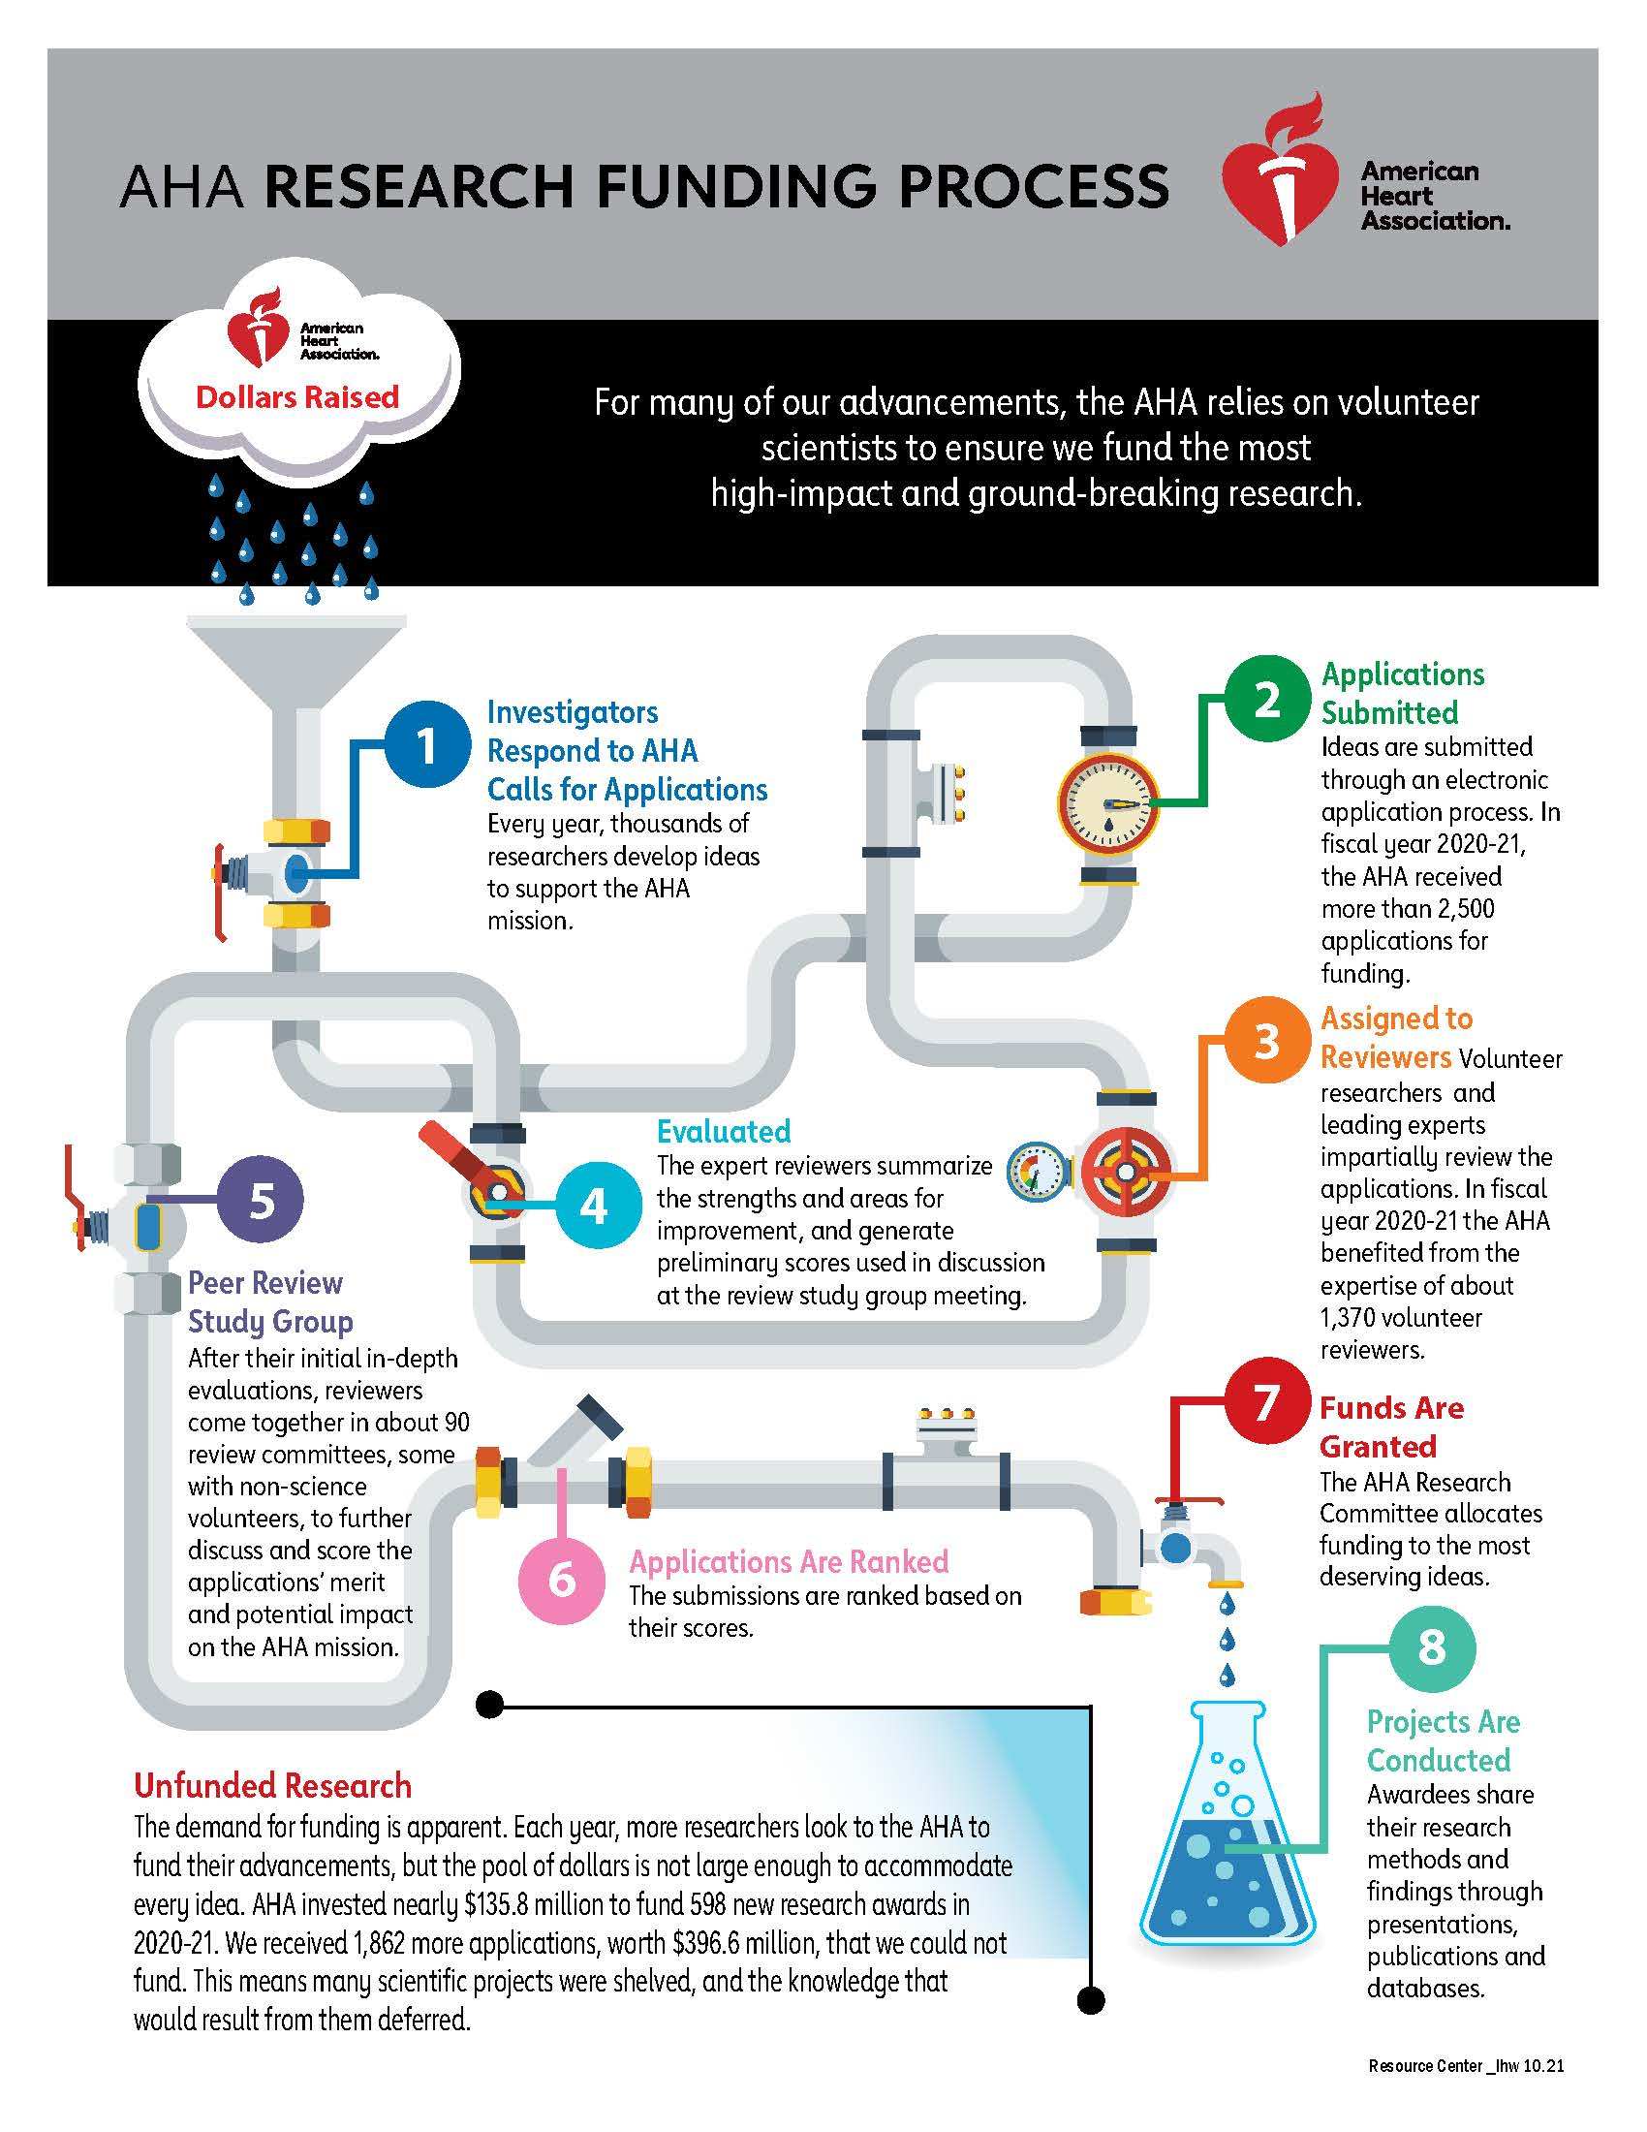
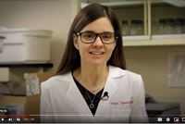
Application Resources https://professional.heart.org/en/research-programs/application-information#resources
Internal & external tools: Fact sheets, articles, videos, online tools
AHA Research Application & Award Process
Step-by-step application instructions
Lay summary
Career development plan
Biosketch
Writing a proposal
Peer Review & scoring

Slide 17
Application TIPs
Some require pre-proposal (LOI)
Follow the instructions on ProposalCentral screens & AHA Application Instructions document
Apply@Heart.org

Slide 18
Summary FOR NON-SCIENTISTS (LAY SUMMARY)
Describe your work to be understood by people who do not have science or medical backgrounds.
How to Share Your AHA-Funded Research
by researcher Georgia Papavasiliou, Ph.D.
https://www.youtube.com/watch?v=04ZEyfM1T2s&list=PLtzTeR_CJNHJBtkiHnTJ-uhYq3WGDYkP5&index=1

Slide 19
Application TIPs
Applicant must be AHA Professional Member Join early!! https://professional.heart.org/en/partners
Application software is Proposal Central - -opens about 60 days prior to deadline
Work on your uploads in advance
https://professional.heart.org/en/research-programs/application-information/required-application-documents

Slide 20
Become a Peer Reviewer professional.heart.org/PeerReview
Study sections by award type & topic
Virtual meeting via Zoom & ProposalCentral
Submit your CV to PeerReview@heart.org
Reviewer-in-Training program for AHA Postdoctoral Fellows
“You learn how to tailor your own grants to avoid the pitfalls you see in other people’s grants.” – Dr. Michael Criqui

Slide 21
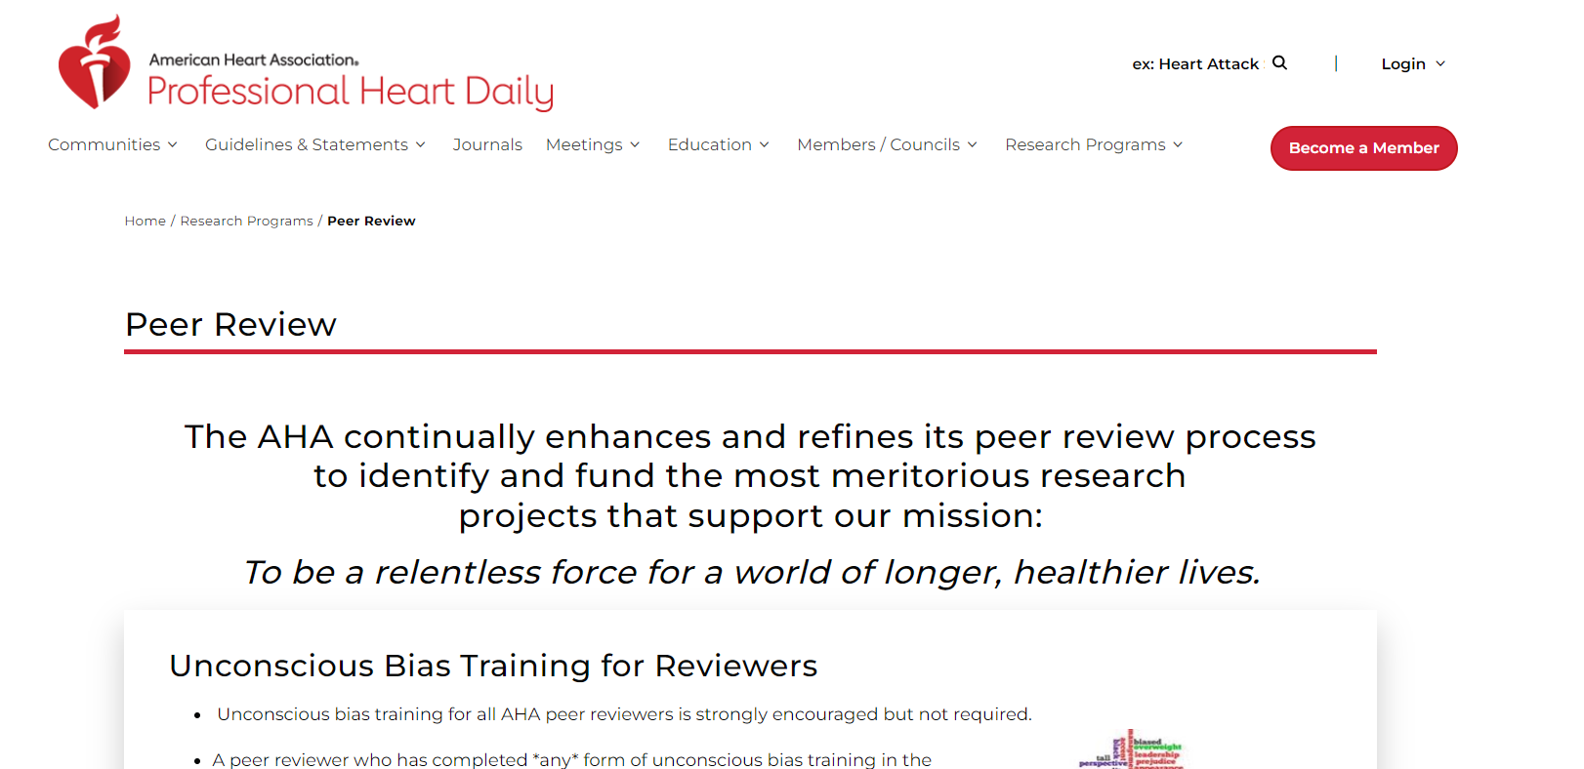
professional.heart.org/PeerReview

Slide 22
WEBINARS
Special sessions for most programs
Listed on Application Information page
All are invited
Get answers to your questions!
Next general session like this one: AHA Research award offerings Application tips Review process Q & A session Wednesday, April 5, 2023 - 10 am CT

Slide 23
Questions/Inquiries
AHA Applications Team
Call 214.360.6107 (option 1)
E-mail apply@heart.org

