Slide 1
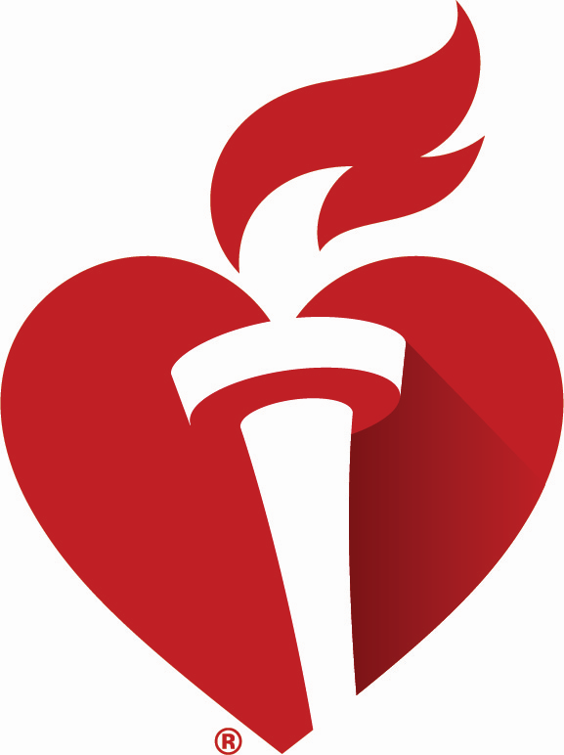
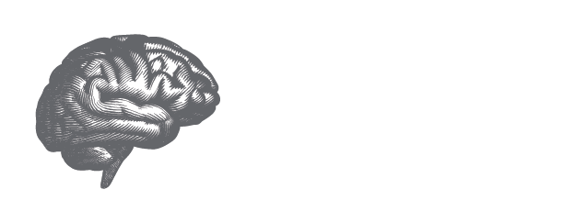
TRANSPORT2: TRANScranial direct current stimulation for POst-stroke motor Recovery - a phase II sTudy
PURPOSE: This study evaluated the impact of different transcranial direct current stimulation (tDCS) dosages (sham, 2mA, and 4mA) combined with modified constraint-induced movement therapy (mCIMT) for improving motor recovery in patients post-stroke.
STUDY DESIGN: A multicenter, phase II, randomized, double-blind trial comparing three intervention groups (sham, 2 mA tDCS, and 4 mA tDCS) over a 10-session treatment period for 15 days.
KEY TAKEAWAYS: The tDCS intervention, regardless of dosage (sham, 2 mA, or 4 mA), did not significantly amplify the effects of CIMT on motor recovery in patients post-stroke, highlighting the need for future trials to explore higher doses.
 | Sham tDCS + mCIMT (n=41) | 2mA tDCS + mCIMT (n=43) | 4mA tDCS + mCIMT (n=43) | P value
Mean change of FM-UE scale (Fugl-Meyer Upper-Extremity) (95% CI) | 4.91 (3.00 – 6.82) | 3.87 (2.00 – 5.74) | 5.53 (3.64 – 7.42) | 0.39
RESULTS: There were no significant differences in outcomes among the three intervention groups in patients post-stroke.
Presented by Gottfried Schlaug, MD, PhD, UMass Chan, Worcester, MA and Wayne Feng, MD, MS, FAHA, Duke University, Durham, NC. International Stroke Conference 2025.
© 2025, American Heart Association. All rights reserved. Results reflect the data available at the time of presentation.
#AHA2
#ISC25

