Slide 1
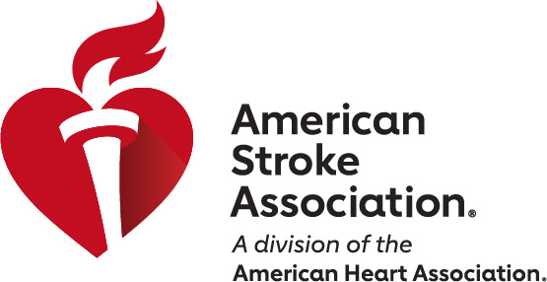
Elevate Your Career:
Share Your Science with Stroke Professionals
Pre-Cons and Stroke Nursing Symposia: February 6, 2024
ISC Sessions: February 7-9, 2024
Phoenix, AZ
Submit your Abstracts to #ISC24
Incorporate video clips, animations, audio presentations and more!
16 Abstract Categories tailored to your field of study.
Get Published in AHA’s Scientific Journal, Stroke.
Opportunity to present your accepted abstracts in-person to a global audience and network with international leaders in the stroke field.
Grow your professional network and discuss your findings via live chat.
Follow for live updates March 17-19!
Abstracts Close Tuesday, August 22nd, 2023 at 11:59pm CT
StrokeConference.org
#ISC24
Abstract Fee: Member $49/Non-Member $99

