Slide 1
AHA
Clinical Update
ADAPTED FROM:
2024 AHA/ACC Guideline on the Management of Lower Extremity Peripheral Artery Disease

Slide 2
Table 1.
Applying Class of Recommendation and Level of Evidence to Clinical Strategies, Interventions, Treatments, or Diagnostic Testing in Patient Care
CLASS (STRENGTH) OF RECOMMENDATION
CLASS 1 (STRONG) Benefit >>> Risk
Suggested phrases for writing recommendations: Is recommended Is indicated/useful/effective/beneficial Should be performed/administered/other Comparative-Effectiveness Phrases†: Treatment/strategy A is recommended/indicated in preference to treatment B Treatment A should be chosen over treatment B
CLASS 2a (MODERATE) Benefit >> Risk
Suggested phrases for writing recommendations: Is reasonable Can be useful/effective/beneficial Comparative-Effectiveness Phrases†: Treatment/strategy A is probably recommended/indicated in preference to treatment B It is reasonable to choose treatment A over treatment B
CLASS 2b (Weak) Benefit ≥ Risk
Suggested phrases for writing recommendations: May/might be reasonable May/might be considered Usefulness/effectiveness is unknown/unclear/uncertain or not well-established
CLASS 3: No Benefit (MODERATE) Benefit = Risk
Suggested phrases for writing recommendations: Is not recommended Is not indicated/useful/effective/beneficial Should not be performed/administered/other
CLASS 3: Harm (STRONG) Risk > Benefit
Suggested phrases for writing recommendations: Potentially harmful Causes harm Associated with excess morbidity/mortality Should not be performed/administered/other
LEVEL (QUALITY) OF EVIDENCE‡
LEVEL A
High-quality evidence‡ from more than 1 RCT Meta-analyses of high-quality RCTs One or more RCTs corroborated by high-quality registry studies
LEVEL B-R (Randomized)
Moderate-quality evidence‡ from 1 or more RCTs Meta-analyses of moderate-quality RCTs
LEVEL B-NR (Nonrandomized)
Moderate-quality evidence‡ from 1 or more well-designed, well-executed nonrandomized studies, observational studies, or registry studies Meta-analyses of such studies
LEVEL C-LD (Limited Data)
Randomized or nonrandomized observational or registry studies with limitations of design or execution Meta-analyses of such studies Physiological or mechanistic studies in human subjects
LEVEL C-EO (Expert Opinion)
Consensus of expert opinion based on clinical experience.
COR and LOE are determined independently (any COR may be paired with any LOE).
A recommendation with LOE C does not imply that the recommendation is weak. Many important clinical questions addressed in guidelines do not lend themselves to clinical trials. Although RCTs are unavailable, there may be a very clear clinical consensus that a particular test or therapy is useful or effective.
*The outcome or result of the intervention should be specified (an improved clinical outcome or increased diagnostic accuracy or incremental prognostic information).
†For comparative-effectiveness recommendation (COR 1 and 2a; LOE A and B only), studies that support the use of comparator verbs should involve direct comparisons of the treatments or strategies being evaluated.
‡The method of assessing quality is evolving, including the application of standardized, widely-used, and preferably validated evidence grading tools; and for systematic reviews, the incorporation of an Evidence Review Committee.
COR indicates Class of Recommendation; EO, expert opinion; LD, limited data; LOE, Level of Evidence; NR, nonrandomized; R, randomized; and RCT, randomized controlled trial.
Gornik, H. L., et al. (2024). 2024 AHA/ACC Guideline on the Management of Lower Extremity Peripheral Artery Disease. Circulation.

Slide 3
Definitions
TERM | DEFINITION
Acute limb ischemia (ALI) | Acute (<2 week) hypoperfusion of the limb that may be characterized by the following features: pain, pallor, pulselessness, poikilothermia, paresthesias, and/or paralysis.
Chronic limb-threatening ischemia (CLTI) | A condition characterized by chronic (>2 wk.) ischemic rest pain, nonhealing wounds/ulcers, or gangrene attributable to objectively proven arterial occlusive disease. Current nomenclature has evolved from the prior commonly used term of critical limb ischemia (CLI) to reflect the chronic nature of this condition and its potentially limb-threatening nature with associated risk for amputation and to distinguish it from acute limb ischemia (ALI).
Major adverse cardiovascular events (MACE) | Variably defined but usually includes death (all-cause or cardiovascular), myocardial infarction, acute coronary syndrome (acute MI, unstable angina), and stroke. May also include heart failure, rehospitalization for cardiovascular causes, and other cardiovascular endpoints.
Major adverse limb events (MALE) | Variably defined but usually includes major amputation and endovascular or surgical lower extremity revascularization (initial or reintervention). May also include ALI.

Slide 4
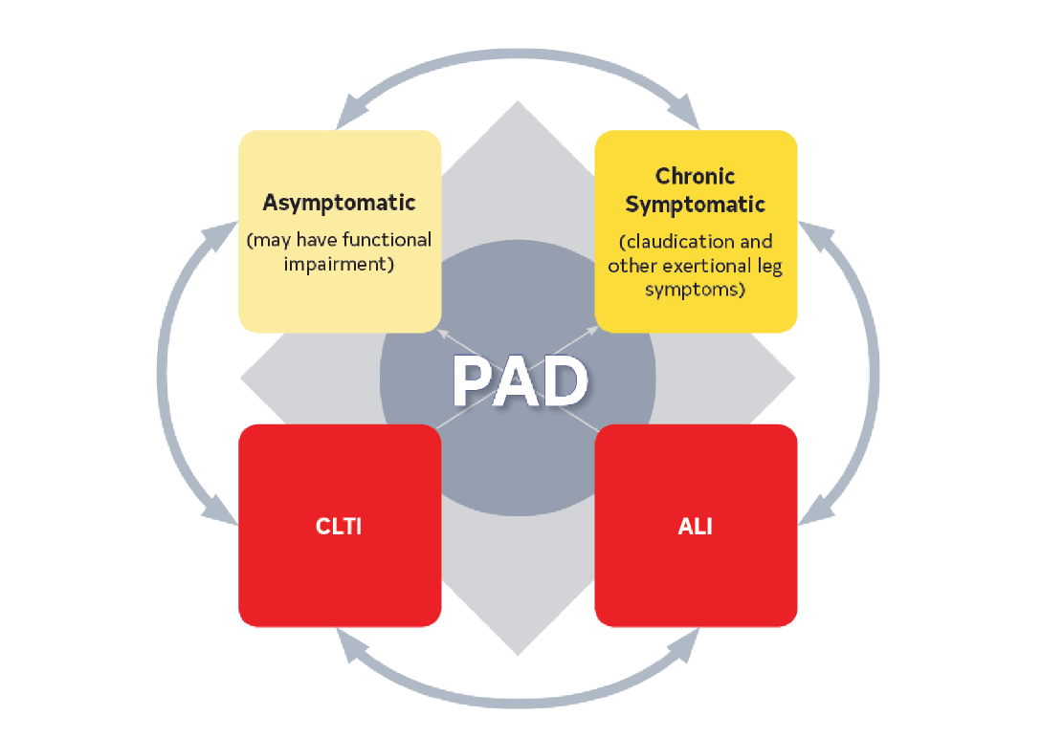
Recognizing Clinical Subsets of PAD
Abbreviations: ALI indicates acute limb ischemia; CLTI, chronic limb-threatening ischemia; and PAD, peripheral artery disease.

Slide 5
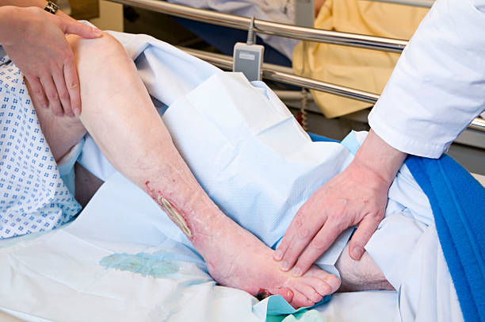

History and Physical Exam for PAD
HISTORY
Claudication
  Pain type: Aching, burning, cramping, discomfort, or fatigue
  Location: Buttock, thigh, calf, or ankle
  Onset/offset: Distance, exercise, uphill, how long for relief after rest (typically <10 min for typical claudication)
Other non-joint-related exertional lower extremity symptoms (not typical of claudication) or symptoms of impaired walking function
  Lower extremity muscular discomfort associated with walking that requires >10 min rest to resolve
  Leg weakness, numbness, or fatigue during walking without pain
Ischemic rest pain
History of nonhealing
or slow-healing lower
extremity wound
Erectile dysfunction
PHYSICAL EXAM
Abnormal lower extremity pulse palpation (femoral, popliteal, dorsalis pedis, or posterior tibial arteries)
Vascular bruit
Nonhealing lower extremity wound
Lower extremity gangrene
Other physical findings suggestive of ischemia like asymmetric hair growth, nail bed changes, calf muscle atrophy, or elevation pallor/dependent rubor.
Abbreviations: PAD indicates peripheral artery disease; and min, minute

Slide 6
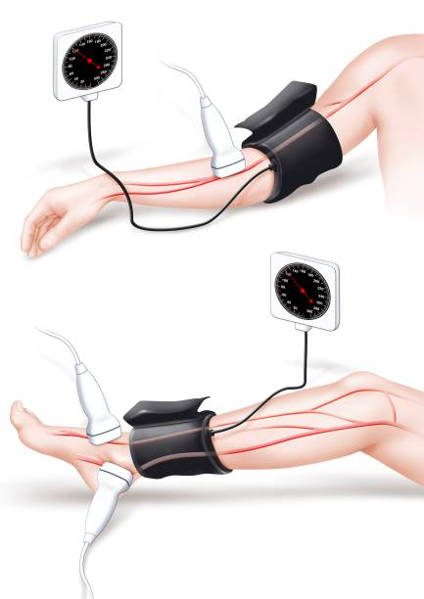
Resting ABI
History or physical examination findings suggestive of PAD
Patients at increased risk of PAD
Patients not at increased risk of PAD and without history or physical examination findings suggestive of PAD
Resting ABI with or without ankle PVR and/or Doppler waveforms
(Class 1)
Screening for PAD with resting ABI with or without ankle PVR and/or Doppler waveforms is reasonable. (Class 2a)
Screening for PAD with the
ABI is not recommended.
(Class 3: No Benefit)
Resting ABI should be reported as abnormal,
borderline, normal, or non-compressible (Class 1)
Abnormal:
ABI ≤0.90
Borderline:
ABI 0.91–0.99
Normal:
ABI 1.00–1.40
Non-compressible:
ABI >1.40
Abbreviations: ABI indicates ankle-brachial index; CLTI, chronic limb-threatening ischemia; PAD, peripheral artery disease; PVR, pulse volume recordings;
SPP, skin perfusion pressure; TBI, toe-brachial index; and TcPO2, transcutaneous oxygen pressure.

Slide 7
Exercise ABI and Additional Physiological Testing
Patients with suspected PAD
Patients with suspected chronic symptomatic PAD
Patients with PAD
Patients with chronic symptomatic PAD
Suspected CLTI
CLTI with nonhealing wounds or gangrene
Non-compressible Resting ABI
Normal or
Borderline Resting ABI
Abnormal Resting ABI
Segmental leg pressures with PVR and/or Doppler waveforms is reasonable to perform in addition to resting ABI to help delineate anatomic level of PAD
(Class 2a)
Toe pressure/TBI with waveforms, TcPO2, and/or SPP is reasonable to perform in addition to resting ABI to establish the diagnosis of CLTI
(Class 2a)
Toe pressure/TBI with waveforms, TcPO2, SPP, and/or other local perfusion measures to determine likelihood of wound healing without or after revascularization
(Class 2a)
TBI with waveforms
(Class 1)
Exercise treadmill ABI testing to evaluate for PAD (Class 1)
Exercise treadmill ABI testing to assess functional status and walking performance
(Class 2a)
Abbreviations: ABI indicates ankle-brachial index; CLTI, chronic. limb-threatening ischemia; PAD, peripheral artery disease; PVR, pulse volume recordings;
SPP, skin perfusion pressure; TBI, toe-brachial index; and TcPO2, transcutaneous oxygen pressure.

Slide 8
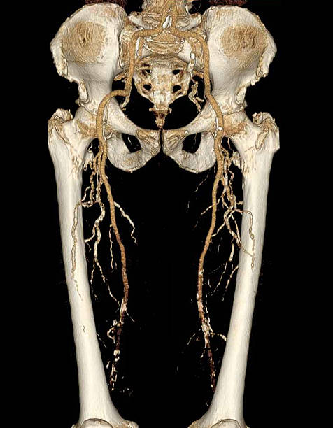
Imaging for PAD
Functional limiting claudication despite GDMT
Revascularization planning
Patients with CLTI
Anatomic Assessment
(Class 1)
Duplex ultrasound
Computed tomography angiography
Magnetic resonance angiography
Catheter angiography
To determine revascularization strategy
Imaging to establish diagnosis
(Class 2b)
Duplex ultrasound
Computed tomography angiography
Magnetic resonance angiography
Suspected PAD with inconclusive ABI and physiological testing
Confirmed diagnosis of PAD in whom revascularization is not being considered
Invasive or noninvasive
imaging should not be performed solely for anatomic assessment
(Class 3: Harm)
Abbreviations: CLTI indicates chronic. limb-threatening ischemia; CTA, computed tomography angiography; GDMT, guideline-directed medical therapy;
MRA, magnetic resonance angiography; and PAD, peripheral artery disease.

Slide 9
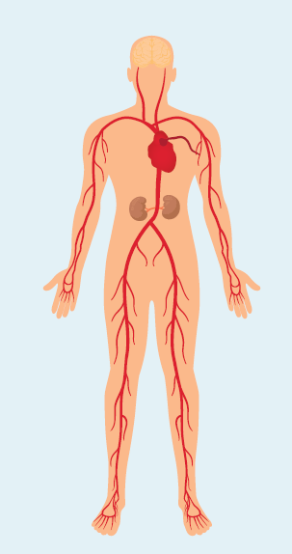
PAD-Related Risk Amplifiers and Health Disparities Increase Risk of MACE and MALE
PAD Risk Amplifiers
Older Age (e.g., > 75 years) and Geriatric Syndromes (e.g., frailty, mobility impairment)
Diabetes
Ongoing Smoking and Other Tobacco Use
Chronic Kidney Disease and End-Stage Kidney Disease
Polyvascular Disease (i.e., coexisting atherosclerotic heart-brain-leg cardiovascular disease)
Microvascular Disease (retinopathy, neuropathy, nephropathy)
Depression
Health Disparities Contributors
Geography (i.e., rural location with less access to health care)
Race and Ethnicity (especially Black, Hispanic, American Indian individuals)
Structural Racism and Implicit Bias
Social Determinants of Health
Chronic Stress
Lower Quality Education and Poor Health Literacy
Lower Income and Less Access to Quality Housing
Limited Access to Quality Food and Exercise
Inadequate Health Insurance
Poor Access to Health Care (preventative care, diagnosis, treatment, revascularizations)
Impact of Health on Jobs/Workplace
Social Determinants of Health
Abbreviations: PAD indicates peripheral artery disease; MACE, major adverse cardiovascular events; and MALE, major adverse limb events.

Slide 10





Consideration for PAD in Older Patients
In older patients with PAD (i.e., age ≥75 years), assessment for geriatric syndromes can be useful to identify high-risk patients, including before revascularization, and to provide safe and goal-concordant care. (Class 2a)
Frailty
Sarcopenia
Malnutrition
Polypharmacy
Impact of amputation
Mobility impairment
Revascularization considerations
Encourage shared decision making to evaluate the utility of endovascular, surgical, or hybrid revascularization procedures to balance risk of complications or loss of independence against the potential for improved quality-of-life and palliation of symptoms with a limited life span.
Abbreviations: PAD indicates peripheral artery disease.

Slide 11
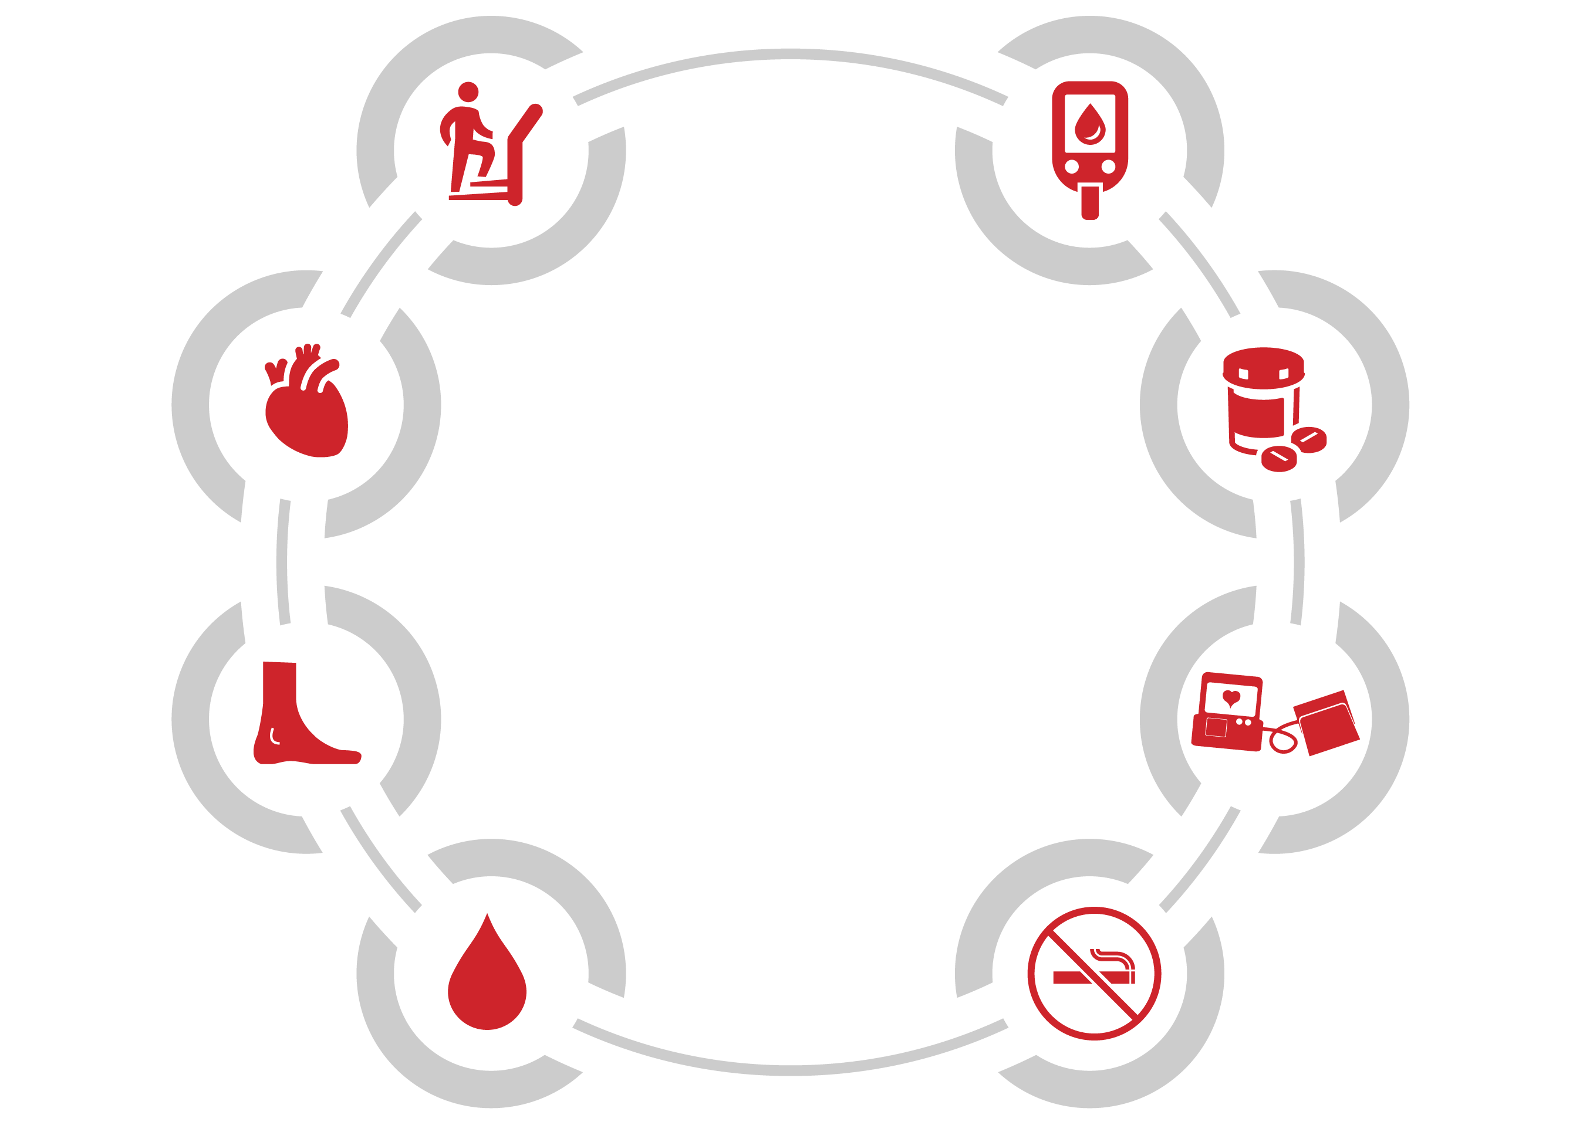
Overview of Medical Therapy and
Preventive Footcare for Patients with PAD
Medications for
Leg Symptoms
Diabetes
Management
Structured Exercise Program
Lipid-Lowering Therapy
Medical
Therapy
of PAD
Preventive Foot Care
Antihypertensive
Therapy
Antiplatelet and Antithrombotic Therapy
Smoking Cessation
Abbreviations: PAD indicates peripheral artery disease.

Slide 12




Anti-platelet therapy in Patients with PAD
Asymptomatic PAD
Revascularized PAD
COR | RECOMMENDATIONS
2a | Single antiplatelet therapy is reasonable to reduce the risk of MACE
COR | RECOMMENDATIONS
1 1 | Endovascular or surgical: antiplatelet therapy is recommended. Endovascular or surgical: rivaroxaban (not caps) 2.5 mg BID + low dose aspirin is recommended to reduce risk of MACE and MALE
2a | Endovascular: DAPT with P2Y12 antagonist and low dose aspirin for 1-6 months is reasonable
2a | If on full-intensity anticoagulation for other indication and are not at a high risk of bleeding, adding single antiplatelet therapy is reasonable
2b | If post prosthetic graft, DAPT with P2Y12 antagonist & low dose aspirin for at least one month may be reasonable
Symptomatic PAD
COR | RECOMMENDATIONS
1 | Single agent antiplatelet therapy with aspirin alone (75-325 mg) or clopidogrel alone is recommended
1 | Rivaroxaban 2.5 mg BID + low dose aspirin is recommended
2b | DAPT without recent revascularization in symptomatic PAD has uncertain benefit
2b | Adding vorapaxar to existing therapy is of uncertain benefit
ALL PAD
COR | RECOMMENDATIONS
3: Harm | In PAD, without another indication, full intensity oral anticoagulation should not be used to reduce the risk of MACE and MALE
Abbreviations: BID indicates twice a day; DAPT, dual anti-platelet therapy; MACE, major adverse cardiac events;
MALE, major adverse limb events; P2Y12, purinergic receptor P2Y; PAD, peripheral arterial disease.

Slide 13



Medical Therapy in Patients with PAD
Lipid Lowering Therapy
Smoking Cessation
COR | RECOMMENDATIONS
1 | High intensity statin to lower LDL-C by ≥ 50%
2a | If LDL-C remains ≥ 70 mg/dL on maximally tolerated statin, adding ezetimibe or a PCSK9 inhibitor is reasonable
COR | RECOMMENDATIONS
1 | Remind patients at every visit to quit or maintain cessation of tobacco use
1 | Pharmacotherapy should be included in tobacco cessation plans combined with counseling and referral to smoking cessation program
1 | Advise patients to avoid secondhand smoke exposure
Antihypertensive Therapy
Diabetes
COR | RECOMMENDATIONS
1 | Antihypertensive therapy to reduce the risk of MACE
1 | SBP goal <130 mmHg DBP goal <80
1 | Use ACEI or ARBs to reduce the risk of MACE
COR | RECOMMENDATIONS
1 | Multidisciplinary team approach
1 | Glycemic control with GLP1-receptor agonist and SGLT2i to reduce risk of MACE
2b | Glycemic control may be beneficial to improve limb outcomes
Abbreviations: ACEI indicates angiotensin converting enzyme inhibitor; ARB, angiotensin II receptor blocker; DBP, diastolic blood pressure; GLP1-a, glucagon-like peptide-1 agonist; LDL, low-density lipoprotein; MACE, major adverse limb events; mmHg, millimeters of mercury; PCSK9i, proprotein convertase subtilsin-kexin type 9; PAD, peripheral artery diseases; SBP, systolic blook pressure; and SGLT2i, sodium-glucose transporter 2 inhibitor.

Slide 14

Preventive Foot Care and Leg Symptom Management in Patients with PAD
Preventive Foot Care
Leg Symptoms
COR | RECOMMENDATIONS
1 | Educating patients & family on preventive foot care
1 | Foot inspection by clinician at every visit
1 | Therapeutic footwear for those at high risk for ulcers/amputation
1 | Comprehensive foot evaluation annually to identify risk factors for ulcers and amputation
2a | Referral to a foot care specialist for preventive care and longitudinal surveillance is reasonable
COR | RECOMMENDATIONS
1 | Cilostazol is recommended to increase walking distance and reduce symptoms
2b | Cilostazol may help reduce restenosis after endovascular therapy in femoropopliteal disease
3: No Benefit | In chronic symptomatic PAD pentoxifylline and chelation therapy are not recommended for treatment of claudication.
3: Harm | In patients with PAD and congestive heart failure cilostazol is not recommended
Abbreviations: PAD indicates peripheral artery disease.

Slide 15


Exercise Therapy for Patients with PAD
Chronic symptomatic PAD
Post revascularization for chronic symptomatic PAD
COR | RECOMMENDATIONS
1 | Supervised exercise therapy is recommended
1 | A structured community-based program with behavioral change techniques is effective
2a | Non-walking structured exercise programs can be beneficial
2b | Usefulness of unstructured exercise programs is uncertain
COR | RECOMMENDATIONS
1 | Supervised exercise therapy is effective
Functionally limiting claudication
COR | RECOMMENDATIONS
1 | Supervised exercise therapy or structured community-based exercise therapy should be the initial treatment option
Abbreviations: PAD indicates peripheral artery disease.

Slide 16

Revascularization for Asymptomatic PAD
COR | RECOMMENDATIONS
2a | In patients with asymptomatic PAD, it is reasonable to perform procedures to reconstruct diseased arteries if needed for the safety, feasibility, or effectiveness of other procedures.
3: Harm | In patients with asymptomatic PAD, revascularization should NOT be performed to prevent the progression of disease.
Abbreviations: PAD indicates peripheral artery disease.

Slide 17


Patient-centered Approach to Revascularization
Start GDMT and assess response
Functional status
Walking performance
Quality-of-life
Revascularization consideration
History and physical
Physiological testing
Imaging studies
Patient-centered discussion
Functionally limiting claudication despite GDMT
Clinical presentation
Severity of symptoms
Anticipated natural history
Degree of functional limitation
Response to GDMT (including structured exercise) thus far
Revascularization strategy
Likelihood of short and long-term benefit
Potential short and long-term procedural risk
Hemodynamically significant PAD
Abbreviations: GDMT indicates guideline-directed management and therapy.

Slide 18
Algorithm for Revascularization for Claudication,
Chronic Symptomatic PAD
Symptoms are functionally limiting and response to GDMT (including structured exercise) is inadequate?
Revascularization not recommended (3: No benefit)
No
Risk/benefit assessment: do potential benefits of revascularization (QOL, walking performance, functional status) outweigh risks? (1)
No
Revascularization is a reasonable treatment option (2a)
Yes
Yes
Hemodynamically significant aortoiliac or femoropopliteal disease
Hemodynamically significant common femoral artery disease
Hemodynamically significant isolated infrapopliteal disease
Continue GDMT including structured exercise (1)
Surgical revascularization is reasonable if perioperative risk is acceptable and technical factors suggest advantages of endovascular approaches (2a)
Endovascular revascularization is effective (1)
Endarterectomy is reasonable, particularly to preserve profunda femoris artery pathways (2a)
Endovascular approaches may be considered if patient is high risk for surgery and/or anatomic factors are favorable (2b)
Effectiveness of endovascular revascularization is unknown (2b)
Effectiveness of surgical revascularization is unknown (2b)
Fem-pop bypass autogenous vein preferred (1)
Abbreviations: GDMT indicates guideline-directed management and therapy; PAD, peripheral artery disease; and QOL, quality of life.

Slide 19
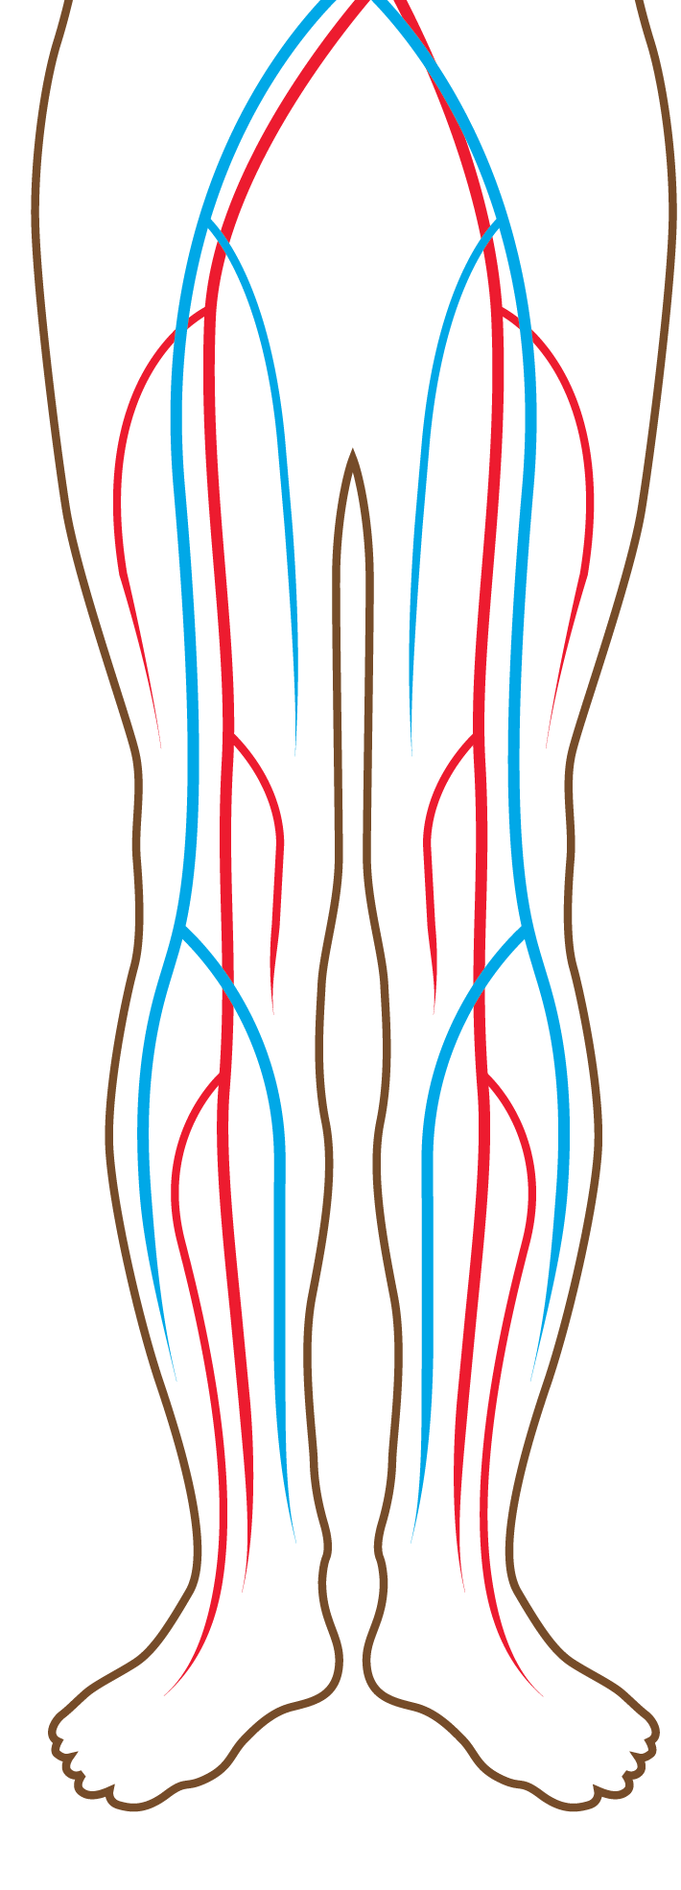
Revascularization for Functionally Limiting Claudication, Recommendations based on Location of Disease
Aortoiliac
Femoropopliteal
COR | RECOMMENDATIONS
1 | Endovascular revascularization is effective
2a | Surgical revascularization is reasonable based on perioperative risk and technical factors
COR | RECOMMENDATIONS
1 | Endovascular revascularization is effective
2a | Surgical revascularization is reasonable based on perioperative risk and technical factors
Common Femoral
Infrapopliteal
COR | RECOMMENDATIONS
2a | Surgical endarterectomy is reasonable
2b | Endovascular approach may be considered based on surgical risk and anatomical factors.
COR | RECOMMENDATIONS
2b | Effectiveness of both endovascular and surgical revascularization is unknown
Note: Patients should have functionally limited claudication and inadequate response to GDMT (including structured exercise) to be considered for revascularization.
Abbreviations: GDMT indicates guideline-directed management and therapy.

Slide 20
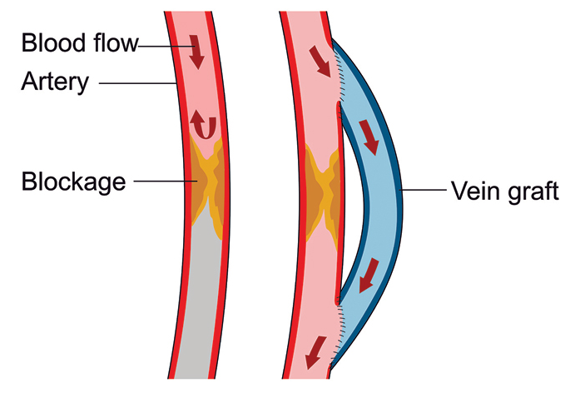
Conduit for Surgical Revascularization for Femoropopliteal Disease
Functionally limiting claudication
Significant
femoropopliteal
disease
Surgical
revascularization
planned
Autogenous vein preferred to prosthetic graft material (Class 1)

Slide 21






Components of Care for CLTI
Selective amputation (most distal level possible)
Multispecialty care team
Wound care and management of infection
Antiplatelet/
antithrombotic therapy and cardiovascular risk reduction
Revascularization
(endovascular, surgical, hybrid)
Pressure offloading
Abbreviations: CLTI indicates chronic limb threatening ischemia.

Slide 22

Revascularization Goals for CLTI
COR | RECOMMENDATIONS
1 | In patients with CLTI, surgical, endovascular, or hybrid revascularization techniques are recommended, when feasible, to minimize tissue loss, heal wounds, relieve pain, and preserve a functional limb.
1 | In patients with CLTI, an evaluation for revascularization options by a multispecialty care team is recommended before amputation.
Abbreviations: CLTI indicates chronic limb threatening ischemia.

Slide 23

Revascularization Strategy for CLTI
COR | RECOMMENDATIONS
1 | In patients undergoing surgical revascularization for CLTI, bypass to the popliteal or infrapopliteal arteries should be constructed with autogenous vein if available.
1 | In patients with CLTI due to infrainguinal disease, anatomy, available conduit, patient comorbidities, and patient preferences should be considered in selecting the optimal first revascularization strategy (surgical bypass or endovascular revascularization).
1 | In patients with CLTI who are candidates for surgical bypass and endovascular revascularization, ultrasound mapping of the great saphenous vein is recommended.
Abbreviations: CLTI indicates chronic limb threatening ischemia.

Slide 24
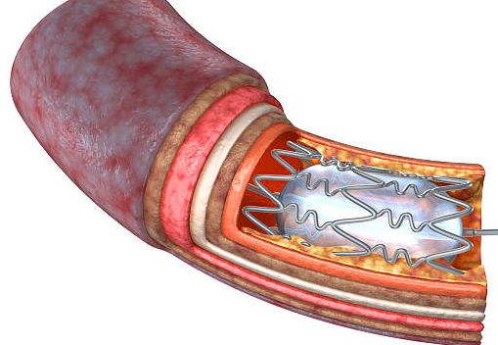
Revascularization Strategy for CLTI-continued
COR | RECOMMENDATIONS
2a | In patients with CLTI for whom a surgical approach is selected and a suitable autogenous vein is not available, alternative conduits such as prosthetic or cadaveric grafts can be effective for bypass to the popliteal and tibial arteries.
2a | In patients with CLTI and nonhealing wounds or gangrene, revascularization in a manner that achieves in-line blood flow or maximizes perfusion to the wound bed can be beneficial.
2a | In patients with CLTI with ischemic rest pain attributable to multilevel arterial disease, a revascularization strategy addressing inflow disease first is reasonable.
Abbreviations: CLTI indicates chronic limb threatening ischemia.

Slide 25

Minimizing Tissue Loss for CLTI:
Pressure offloading is key
COR | RECOMMENDATIONS
1 | Patients with CLTI and diabetic foot ulcers should receive pressure offloading, when possible, to promote tissue growth and wound healing.
1 | Patients with PAD and prior diabetic foot ulcers should be referred for customized footwear that accommodates, protects, and fits the shape of their feet.
2b | Patients with CLTI and foot ulcers who do not have diabetes may be considered for pressure offloading to promote tissue growth and wound healing.
Abbreviations: CLTI indicates chronic limb threatening ischemia; and PAD, peripheral artery disease.

Slide 26

Wound Care and Infection for Patients with CLTI
COR | RECOMMENDATIONS
1 | Prompt management of foot infection with antibiotics, debridement, and other surgical management is recommended.
1 | With nonhealing wounds, wound care should be provided to optimize the wound healing environment after revascularization with the goal of complete wound healing.
2b | In nonhealing diabetic foot ulcers, hyperbaric oxygen therapy may be considered to assist in wound healing after revascularization.
Abbreviations: CLTI indicates chronic limb threatening ischemia.

Slide 27

“No Option” Patients
In patients with CLTI for whom revascularization is not an option:
COR | RECOMMENDATIONS
2b | Usefulness of prostanoids is uncertain.
2b | Arterial intermittent pneumatic compression devices may be considered to augment wound healing or ameliorate ischemic rest pain.
2b | Venous arterialization may be considered for limb preservation if a lack of outflow to the foot is observed
Abbreviations: CLTI indicates chronic limb threatening ischemia.

Slide 28

Amputation in Patients with CLTI
COR | RECOMMENDATIONS
1 | For those who require amputation, evaluation should be performed by a multispecialty care team to assess for the most distal level of amputation that facilitates healing and provides maximal functional ability
1 | Primary amputation is indicated when life over limb is the prevailing consideration and clinical factors suggest the threatened limb to be the cause of the patient’s instability
1 | A patient-centered approach using objective classification of the threatened limb, patient risk, and anatomic pattern of disease is combined with patient and family goals is recommended to identify those patients in whom primary amputation or palliative management is appropriate
1 | When undergoing a minor amputation, a customized program of follow-up care that can include local wound care, pressure offloading, serial evaluation of foot biomechanics and use of therapeutic footwear is recommended to prevent wound recurrence
2a | Retrospective assessment of institutional outcomes with objective limb threat classification tools can be useful for quality improvement
Abbreviations: CLTI indicates chronic limb threatening ischemia.

Slide 29
ALI Diagnosis and Management
Suspected ALI
All Patients With ALI
Acutely cold, painful, pulseless leg (symptoms <14 days)
Heparin unless contraindicated (1)
Comprehensive history/ physical examination
Assess for underlying cause (2a)
Suspected ALI
Testing for acute CV cause (EKG, echocardiography, heart rhythm monitoring) (2a)
Emergency clinical evaluation including: symptoms, motor and sensory assessment, arterial and venous Doppler signals (1)
Abbreviations: ALI indicates acute limb ischemia; CV, cardiovascular; and EKG, electrocardiogram.

Slide 30
ALI Diagnosis and Management
Management Based on Clinical Assessment and Doppler Signals
Suspected ALI
Emergency clinical evaluation including symptoms, motor and sensory assessment, arterial and venous Doppler signals (1)
Audible arterial / Audible venous
Inaudible arterial / Audible venous
Inaudible arterial / Inaudible venous
Category I: Viable
Normal motor function
No sensory loss
Motor function assessment
Category III: Irreversible
Complete loss of motor function
Complete sensory loss
Category IIa: Marginally threatened
Sensory loss limited to toes if present
No muscle weakness
Category IIb: Immediately threatened
Sensory loss more than toes
Mild or moderate muscle weakness
Revascularization (urgent) AND anticoagulation with heparin, unless contraindicated (1)
Revascularization should not be performed (i.e. primary amputation of non-viable tissue is indicated) (3: Harm)
Salvageable if treated urgently
Salvageable if treated emergently
Monitor/treat for compartment syndrome (fasciotomy) (1)
Revascularization (urgent Category IIa/emergency Category IIb) AND anticoagulation with heparin, unless contraindicated (1)
Concurrent/early amputation if prolonged ischemia (2a)
Monitor/treat for compartment syndrome (fasciotomy) (1)
Prophylactic fasciotomy (2a)
Abbreviations: ALI indicates acute limb ischemia.

Slide 31
Revascularization for ALI
Revascularization
COR | RECOMMENDATIONS
1 | In patients with ALI and a salvageable limb, revascularization (endovascular or surgical, including catheter-directed thrombolysis) is indicated to prevent amputation.
2a | In patients with ALI and a salvageable limb who are treated with catheter-directed thrombolysis, adjunctive revascularization (i.e., endovascular or surgical) procedures can be useful.
2b | In patients presenting with ALI from chemotherapeutic or prothrombotic viral states, it may be reasonable to take a more deliberate planning strategy before engaging in a definitive revascularization or medical treatment plan.
3: Harm | In patients with ALI with a nonsalvageable limb, revascularization of nonviable tissue should not be performed.
Abbreviations: ALI indicates acute limb ischemia.

Slide 32
Acute Limb Ischemia
Minimizing Tissue Loss
Establishing Etiology
COR | RECOMMENDATIONS
1 | Patients with ALI should be monitored and treated for compartment syndrome with fasciotomy after revascularization to prevent reperfusion injury and need for amputation.
2a | In patients with ALI with a threatened but salvageable limb, prophylactic fasciotomy is reasonable.
2a | In patients with ALI and prolonged ischemia in whom revascularization is performed, concurrent and early amputation can be beneficial to avoid morbidity of reperfusion.
COR | RECOMMENDATIONS
1 | History and physical examination should be performed to determine the cause of thrombosis or embolization.
2a | Testing for a cardiovascular cause of thromboembolism can be useful.
Abbreviations: ALI indicates acute limb ischemia.

Slide 33
Longitudinal Follow-Up of Patients with PAD
COR | RECOMMENDATIONS
1 | With or without revascularization, routine clinical evaluation, including assessment of limb symptoms and functional status, lower extremity pulse and foot assessment, and progress of risk factor management is recommended.
1 | Coordination among specialists to improve management and outcomes.
1 | With or without revascularization, periodic assessment of functional status and health-related QOL.
1 | Long-term use of GDMT to prevent MACE and MALE is recommended.
1 | After lower extremity revascularization include periodic clinical evaluation of lower extremity symptoms and pulse and foot assessment is recommended.
1 | After lower extremity revascularization with new lower extremity signs or symptoms, ABI and arterial duplex ultrasound is recommended.
COR | RECOMMENDATIONS
2a | After infrainguinal, autogenous vein bypass graft(s) without new lower extremity signs or symptoms, it is reasonable to perform ABI and arterial duplex ultrasound surveillance within the first 1 to 3 months post procedure, then repeat at 6 and 12 months, and then annually.
2a | After endovascular procedures without new lower extremity signs or symptoms, it is reasonable to perform ABI and arterial duplex ultrasound surveillance within the first 1 to 3 months post procedure, then repeat at 6 and 12 months, and then annually.
2b | After infrainguinal, prosthetic bypass graft(s) without new lower extremity signs or symptoms, the effectiveness of ABI and arterial duplex ultrasound surveillance is uncertain.
2a | Telehealth can be used for vascular evaluation and management and longitudinal follow-up, depending on the urgency of presenting symptoms.
Abbreviations: ABI indicates ankle-brachial index; GDMT, guideline-directed management and therapy;
MACE, major adverse cardiovascular events; MALE, major adverse limb events; PAD, peripheral artery disease; and QOL, quality of life.

Slide 34







Evidence Gaps
Studies to compare telehealth technology vs. facility-based supervised exercise therapy.
Clinical trials in asymptomatic patients
Benefit of screening in those at-risk
Benefit of medical therapies to prevent MACE and MALE
RCT or registry data for chronic symptomatic PAD treated by exercise therapy, endovascular management, and surgical management with hard outcomes, including MACE and MALE.
Studies to identify new medical therapies to improve functional status
Studies on patients who have undergone revascularization procedures
Determination of optimal antiplatelet and antithrombotic regimen.
Comparative effectiveness studies of endovascular devices for revascularization of PAD.
Studies comparing outcomes of different strategies for revascularization of CLTI (in-line flow, angiosome, would blush).
Studies to determine the ideal timing and modality for vascular surveillance testing post-revascularization procedures.
Studies on the effect of shared decision-making strategies in the management of chronic symptomatic PAD and CLTI
Development of patient-reported metrics of functional status/walking performance for outcome measures of studies of revascularization.
Abbreviations: CLTI indicates chronic limb-threatening ischemia; GDMT, guideline-directed management and therapy;
MACE, major adverse cardiovascular events; MALE, major adverse limb events; and PAD, peripheral artery disease.

Slide 35








Advocacy Priorities
Access to Care/Guideline implementation
Disparities
National Initiatives
2
Collaborative teamwork between all specialties
Address racial disparity gap in amputation, revascularization, and risk modification
20% reduction in non-traumatic
amputations by 2030
Broad dissemination and implementation of these guidelines with focus on quality outcomes
Creation of national registry of nontraumatic lower extremity amputation to identify opportunities for improvement and to unmask factors associated with disparities in treatment.
Strategies to improve the use of structured exercise therapy.
Telemedicine and remote patient-monitoring devices.
Abbreviations: PAD indicates peripheral artery disease.

Slide 36
Acknowledgments
Many thanks to our Guideline Ambassadors who were guided by Dr. Elliott Antman in developing this translational learning product in support of the 2024 AHA/ACC Guideline on the Management of Lower Extremity Peripheral Artery Disease.
Dr. Nicholas Brownell
Dr. Trevor Cline
Dr. Xing Dai
Dr. Eson Ekpo
Dr. Prerna Gupta
Dr. Joyce Han
Dr. Usman Hasnie
Dr. Jake Mayfield
Dr. Eman Rashed
The American Heart Association requests this electronic slide deck be cited as follows:
Brownell, N., Cline, T., Dai, X., Ekpo, E., Gupta, P., Han, J., Hasnie, U., Mayfield, J., Rashed, E., Reyna, G., Bezanson, J. L., & Antman, E. M. (2024). AHA Clinical Update; Adapted from: [PowerPoint slides]. Retrieved from the 2024 AHA/ACC Guideline on the Management of Lower Extremity Peripheral Artery Disease. https://professional.heart.org/en/science-news.

