Slide 1
Welcome! Webinar for 2023 Research Supplement to Promote Diversity in Science For current AHA awardees who wish to support a pre- or postdoctoral fellow from an under-represented racial or ethnic group in science and medicine.
Professional.heart.org/Application Information

Slide 2
American Heart Association
Research Supplement
to
Promote Diversity in Science
Q & A for Applicants
January 17, 2023

Slide 3
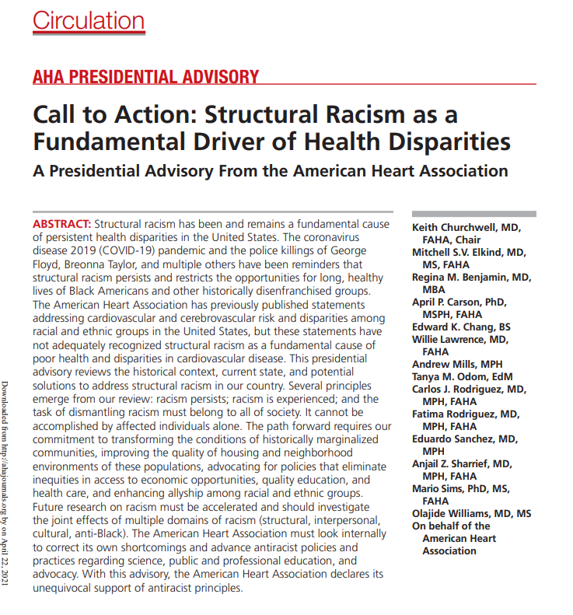
$100M for Health Equity & Structural Racism Research
New research programs & grants focused on health inequities & structural racism
Expand investigator diversity: Research opportunities for underrepresented racial & ethnic groups

Slide 4
Research Supplement to Promote Diversity in Science
PURPOSE
Enables current AHA awardees to identify and serve as mentors for predoctoral and postdoctoral fellows from underrepresented racial and ethnic groups in science and medicine (Black/African American, Hispanic/Latino, American Indian/Alaskan Native, or Native Hawaiian/Pacific Islander).
Fellow initiates the application;
joint proposal submission.

Slide 5
TIMELINE
April | Unconscious Bias Training for Peer Reviewers (Attendance is required)
April 21 | Application assignments will be available in Proposal Central. A notification email will be sent to each reviewer with assignments
May 12 | Reviewers submit critiques and final scores into Proposal Central (no virtual peer review meeting).
ProposalCentral open for proposals: | December 1, 2022
Proposal deadline: | Wednesday, February 1, 2023
Award start date: | April 1, 2023

Slide 6
ELIGIBILITY
MENTOR/CURRENT AHA AWARDEE Currently-funded AHA faculty awardees; at least one year of funding remaining on original award term at the time of activation (April 1, 2023). AHA Institutional Research Enhancement Award (AIREA) AHA Merit Award Career Development Award Collaborative Sciences Award Established Investigator Award Innovative Project Award Transformational Project Award Project PIs of a funded Strategically Focused Research Network | FELLOW/TRAINEE **Initiates the proposal & is the PI** Identifies as member of an underrepresented racial or ethnic group in science and medicine Black/African American Hispanic/Latino American Indian/Alaskan Native Native Hawaiian/Pacific Islander Other Eligibility Requirements: 2023 research supplement to promote diversity in science - professional heart daily | american heart association | CO-MENTOR(S) A co-mentor is not required to be a current AHA awardee Up to two additional co-mentors are permitted but are not required.

Slide 7
Proposed Research Plan (3-page limit)
The fellow and mentor should collaboratively develop
a thoughtfully planned, systematic proposal
aimed at clearly answering an investigative question
in cardiovascular or cerebrovascular research
related to the mentor’s existing AHA award.
Because the fellow receives only a stipend from the award,
additional monetary support for the proposed work MUST come from the mentor's laboratory. Therefore, the proposal will likely be related to the mentor's currently funded work. The mentor should address the relationship of the proposal to ongoing work in their laboratory, and how the proposal will contribute toward the fellow’s training and career development.

Slide 8
responsibilities
MENTOR
Proposed research plan
Biosketch
Past and current trainees
Research training plan
Research project environment
Primary mentor should work with any co-mentor to obtain content for the required documents.
See sponsor/mentor information page
FELLOW/MENTEE/TRAINEE
FELLOW INITIATES THE APPLICATION
Proposed research plan
Biosketch
Summary For Non-scientists
The fellow must add any co-mentor in the third-party section of the application form in ProposalCentral.
CO-MENTOR(S)
Content for the required documents.
VIew sponsor/mentor information page

Slide 9
restrictions
The fellow may submit only one Research Supplement to Promote Diversity in Science application per deadline.
Mentor may be named on only one Research Supplement to Promote Diversity in Science application per deadline.
The fellow may hold only one AHA award at a time.
AHA allows supplementation from other sources to meet institution’s stipend and benefit levels. However, trainee may not hold comparable award (such as another fellowship) as a source of supplementation.
Fellow must resign the award if promoted to a staff or faculty position.
Mentor may supervise no more than four AHA-funded fellows (pre- and/or postdoc) and no more than two AHA-supported student fellows (undergraduate and/or medical/graduate students) at any time.
Restriction does not apply to co-mentors.
AHA strategically focused research network fellows are excluded.

Slide 10
Most frequently asked questions
A: only applicants who identify as members of the racial/ethnic groups on thE list are eligible.
A: Pre-doctoral fellow from underrepresented group with F-1 Visa or a J-1 Visa may apply for the 2023 Research Supplement to Promote Diversity in Science.
A: Recognizing the unique challenges that clinicians experience in balancing research and clinical activity, this award Aims to be as flexible as possible to enable applicants to develop academic careers in research alongside fulfilling clinical service commitments.
For clinical appointments, the AHA may approve up to 6-month deferral for academic training calendar delays.
A: THE FUNDING WILL GO TO THE MENTOR’S INSTITUTION, WHICH Will pay THE FELLOW. FUNDING MAY NOT GO TO AN INTERNATIONAL INSTITUTION.

Slide 11
Most frequently asked questions
FROM AHA AWARD NETWORK PERSONNEL
A. IF A NETWORK CENTER OR TRAINING CENTER PI IS ALSO A PROJECT PI, THEY ARE ELIGIBLE TO APPLY.
IF THEY ARE NOT A PI ON A PROJECT CONCURRENTLY, THEY ARE NOT ELIGIBLE.
A: AN APPLICANT MAY SUBMIT ONLY ONE RESEARCH SUPPLEMENT TO PROMOTE DIVERSITY IN SCIENCE APPLICATION PER DEADLINE. A HERN COORDINATING CENTER DIRECTOR IS NOT BE ELIGIBLE TO APPLY BUT EACH PROJECT PI MAY APPLY.
A: AS WITH ALL APPLICANTS, MUST MEET ALL ELIGIBILITY REQUIREMENTS.

Slide 12
Improve Your Chance
of future Funding
https://professional.heart.org/en/research-programs/application-information#resources

Slide 13
Application TIPs
Applicant must be AHA Professional Member. Join early!! https://professional.heart.org/en/partners
Follow the instructions on ProposalCentral screens & AHA Application Instructions document

Slide 14
Summary FOR NON-SCIENTISTS (LAY SUMMARY)
Describe your work to be understood by people who do not have science or medical backgrounds.
How to Share Your AHA-Funded Research
by researcher Georgia Papavasiliou, Ph.D.
https://www.youtube.com/watch?v=04ZEyfM1T2s&list=PLtzTeR_CJNHJBtkiHnTJ-uhYq3WGDYkP5&index=1

Slide 15
PEER REVIEW CRITERIA
CRITERION 1
NON-SCIENTIST SUMMARY
5% of Score
Impact on Mission
CRITERION 3
MENTOR/TRAINING
PLAN
& ENVIRONMENT
35% of Score
CRITERION 2
EVALUATION OF THE FELLOW
30% of Score
CRITERION 4
EVALUATION OF THE PROPOSAL
30% of Score

Slide 16
AHA Mission
To be a relentless force for a world of longer, healthier lives
To be a relentless force:
We are unyielding in our commitment to fund research, shape stronger health policies, and implement programs that save lives.
For a world:
We’re going beyond borders, both literal and symbolic, to ensure equitable access to quality care.
Of longer, healthier lives: We’re creating a culture of health that enables people to enjoy more years and more life in those years.

Slide 17
PROPOSAL CENTRAL

Slide 18
QUESTIONS Apply@heart.org

