Slide 1
Committee Membership Information Packet
Join Us on this Journey!

Slide 2
Contents
History of the PAD Collaborative
PAD Collaborative Member Organizations
Structure of the PAD Collaborative:
Mission and National Acton Plan Goals
Goal Committee Member Responsibilities
Nomination Form
Application Timeline & Process
Resources
PAD NAP Executive Summary
LINK to National Action Plan

Slide 3
History of The PAD Collaborative: The PAD National Action Plan (NAP)
The PAD National Action Plan (NAP)represents a collaborative effort of 26 organizations and more than 50 participants.
Work on the NAP began in 2018 at a PAD Roundtable hosted at the the NIH National Heart, Lung and Blood Institute. Roundtable participants included health care professionals, governmental and nonprofit organizations, patient advocacy groups and PAD patients.
The attendee’s developed strategic goals, actions and tactics that were refined into the PAD National Action Plan at a PAD Summit conveyed by the American Heart Association in 2021.
The Plan was finalized in May of 2022. The National Action Plan serves as the framework for the PAD Collaborative.
The PAD Collaborative, established in August 2022, unites organizations and experts committed to advancing the PAD NAP to increase public awareness and understanding of PAD, prevent complications, address health barriers and improve quality of life for people living with the disease. The Collaborative is guided by a Steering Group with implementation activities led by 6 Goal Committees.

Slide 4
PAD Collaborative Committed Organizations
American Assoc. of Cardiovascular & Pulmonary Rehab.
American College of Cardiology
American Diabetes Association
American Heart Association*
American Podiatric Medical Association
Association of Black Cardiologists
Association for the Advancement of Wound Care
Centers for Disease Control and Prevention
National Heart Lung & Blood Institute, NIH
Society for Interventional Radiology
Society for Cardiovascular Angiography & Interventions
Society for Vascular Medicine
Society for Vascular Nursing
Society for Vascular Surgery
Vascular Cures
VIVA
Women Heart

Slide 5
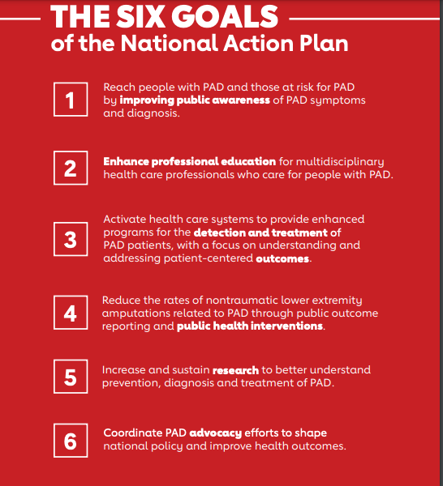
Snapshot: Mission and National Action Plan Goals
Mission:
The PAD Collaborative ​
unites organizations and experts ​
committed to advancing the ​
PAD National Action Plan to increase public awareness and understanding of PAD, prevent complications, address health barriers and improve quality of life for people living with the disease

Slide 6
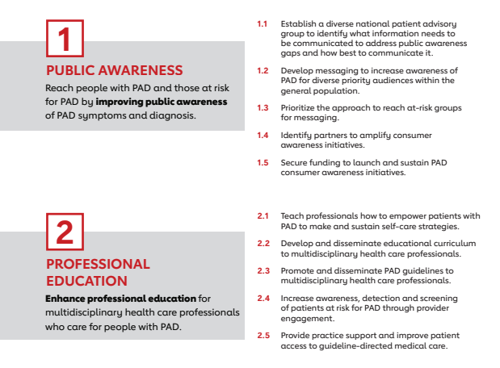
Summary of Goals and Actions
* See National Action Plan for all 101 Tactics

Slide 7
Summary of Goals and Actions
* See National Action Plan for all 101 Tactics

Slide 8
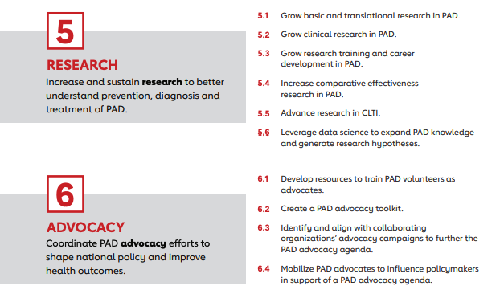
Summary of Goals and Actions
* See National Action Plan for all 101 Tactics

Slide 9
Goal Committee Member Charge
Goal Committee Members. Goal Committee members will work together to execute and advance prioritized plan tactics specific to each goal, as outlined in the PAD NAP. This group will be comprised of volunteers and organization representatives active in the creation of the NAP as well as other individuals interested in implementation of the specific NAP goals. Goal Committee members play an instrumental role in determining and activating pathways for goal implementation. Goal Committee meeting cadence is at the discretion of each Goal Committee Chair and can vary from monthly to bimonthly.
Goal Committee Vice Chair. The Vice Chair works with the Committee Chair to facilitate, coordinate and communicate with committee members– ensuring that the volunteers are actively engaged in advancing the prioritized goals/ tactics identified in the PAD National Action Plan. The Vice-Chair should also seek to develop an understanding of the overall goals of the Committee and build connections to prepare him/herself to serve in the Goal Committee Chair role.
Goal Committee Chair. The Chair will lead strategy for each goal area implementation. They will bring Goal Committee members together to advance prioritized plan tactics. The) Chair will be an individual volunteer leader or organizational representative active in PAD NAP creation or are interested in supporting plan implementation. The Goal Committee Chair is expected to be an active participant in the Collaborative providing progress updates and recommendations at each of the quarterly Collaborative meeting as well as some Steering Group Meetings. Chairs are expected to coordinate calls of their teams at least monthly. The appointment will last for 2 years with a transition period in July. The first transition will be in July 2023 where one of two current Goal Group Leaders will transition out of their role and a new Vice Chair will join.
Note: Steering Group elects chair and vice chair: Committee chair and vice chair elect committee members

Slide 10
Goal Committees
Public Awareness Committee (Goal 1)
Professional Education Committee (Goal 2)
Detection and Treatment Committee (Goal 3
Public Health Committee (Goal 4)
Research Committee (Goal 5)
Advocacy Committee (Goal 6)
PAD Collaborative Chair: Marc Bonaca, MD
AHA PAD Collaborative Staff Members: Lisa Howard (Associate Program Manager) and Valerie Weber (National Program Lead)
Past Collaborative Chairs: Amy Pollak, MD, Aruna Pradhan, MD and Naomi Hamburg MD
For questions, please reach out to PADCollaborative@heart.org

Slide 11
Committee Interest Timeline & Process
Application Cycle
March 15 – April 14 Call for committee interest for vice chairs and committee members.
May Review of committee interest forms
June 15 – June 30 Committee rosters updated / new vice chair identified
July 1 New vice chair term begins *
July 1 – July 31 New member onboarding meetings
Please reach out to PADCollaborative@heart.org
* Note: people can join committees throughout the year by reaching out to the committee chair/vice chair.

Slide 12
Committee Makeup
In order to ensure the Committees will provide diverse perspective and resources needed to advance the PAD National Action Plan goals, member forms will be reviewed and assessed using these categories:
Diversity of Expertise
Leadership in Peripheral Artery Disease focused activities
Geographic Diversity
Steering Group members are responsible for electing Committee chair and vice chairs from nominated candidates. Committee chair and vice chair are responsible for electing committee members

Slide 13
PAD Collaborative Core Values as Outlined in Charter
We are inclusive. We actively welcome and value partners with different experiences, backgrounds, attributes, abilities, and perspectives. We strive to provide seats at the leadership table that bring diversity to our collaborative effort.
We are committed to advancing racial and health equity. We understand that systemic issues have a historical context that is racially rooted and can only be mitigated by interventions that take an intersectional lens. We are dedicated to working together to implement goals and tactics outlined in the PAD NAP that center racial equity in their implementation to improve the awareness, diagnosis and treatment of PAD.
We are accountable. We acknowledge and assume responsibility for our actions. We seek to be held accountable by our partners and the communities they serve, and we value and encourage open and honest feedback. We will continually examine our processes through regular evaluations, and we are committed to learning, reflection, and change.
We are respectful. We communicate and foster relationships in a generous, considerate, and compassionate way. We are not patronizing or harmful in our interactions with our partners. We are mindful of power dynamics and aspire to not be paternalistic.
We are collaborative. We work together for the common good and shared success. We are committed to being active partners by sharing resources, training, and technical assistance. We strive to build long-term relationships and collaborations with partners that support their growth and success.
We are transparent. We are transparent in our operational practices and how we make decisions.
We believe in science. Our work will be guided by science and research.

Slide 14
Resource Documents
The PAD National Action Plan
Exec Summary

